Slide 1
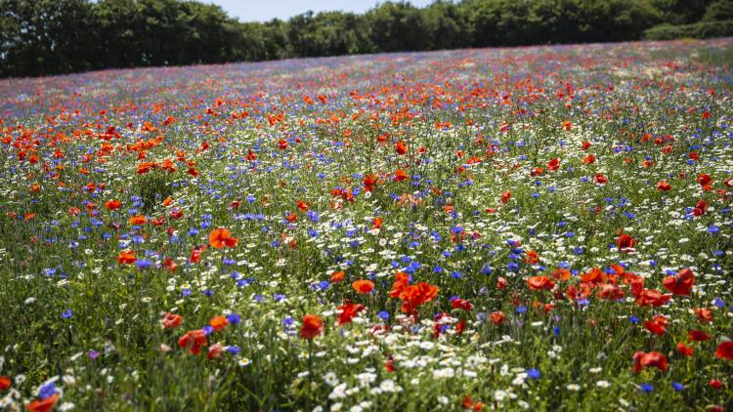
Paradise Pastures - An ‘Invisible World’

Slide 2
How does the Paradise Pastures Project Work?
For the first few sessions we will be completing the challenges set by the ‘Whatifs’ - developing our practical science skills and exploring the nature (biodiversity) in our school grounds.
After that you will come up with your own scientific question to investigate based on something that has interested you, decide how best to answer that question and then plan and complete an investigation to in order to answer your question.

Slide 3
We are the ‘Whatifs’. We enjoyed a peaceful, sleepy winter sheltered underneath the fallen leaves of autumn and have recently been enjoying the bright spring days. As we edge towards summer the plants here in Paradise Pastures have begun growing furiously in the longer, warm days. Life seemed like it couldn’t get better!
However, we have received warning through the ‘Wood Wide Web’, that the ‘Justsos’ have been getting their strimmer ready and that a dreaded ‘mowing’ is just around the corner. The ‘Justsos’ are only trying to keep things tidy, but the problem is that they tend it like everything around the place to look ‘Justso’. However, we know that if they left Paradise Pastures alone to grow more wild then that would be good for the plants, animals and fungi. As in - ‘Whatif they just left it alone?’
If only they could take a closer look! We need you to help us by helping them to see just how amazing and interesting our ‘Invisible World’ of Paradise Pastures is so that they can realise that the best way to help might actually be to let it grow a little wild!
Over the next few lessons we have 3 challenges for you to complete and 3 tinctures for you to drink, which we think will help you find out about the amazing Invisible world of Paradise Pastures. We have asked your teacher to draw a giant map of Paradise Pastures for you on the wall. This will come handy as a place for recording what you find out. Good luck!

Slide 4
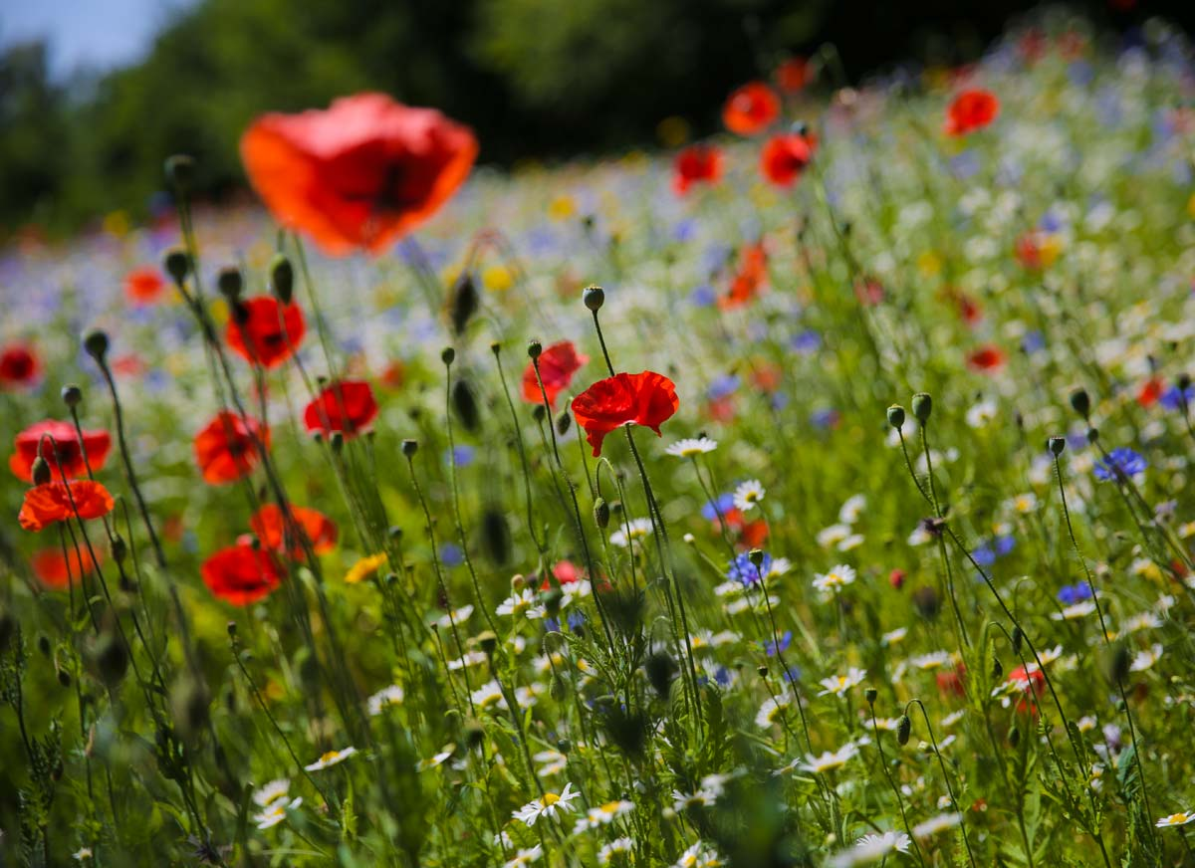
Outcomes for today’s lesson:
Practise identifying common local plants
Investigate the ‘Invisible Underworld’ recording what the environment is like underground and identifying the living things we find.
Practice using scientific equipment to take measurements and make observations.
Search for, and suggest, patterns or relationships between things in nature.

Slide 5
Can you give me any examples from nature about possible patterns, relationships or links between variable (things) that you have noticed before?
For example, I’ve noticed that……
‘every spring the starlings return’
‘when my dog runs a lot he starts to pant quickly’
‘in summer when it rains my grass grows a lot’

Slide 6
Summarising what we learnt at the 2 locations:
As a group read through the information you recorded about the 2 locations.
Decide upon 3 things to say about each location that you feel best sums it up in terms of what it was like there and what you found.
Record these 3 points on a small piece of paper and get ready to tell the rest of the class.

Slide 7
Outcomes for today’s lesson:
Practise identifying common local plants
Investigate the ‘Invisible Underworld’ recording what the environment is like underground and identifying the living things we find.
Practice using scientific equipment to take measurements and make observations.
Search for, and suggest, patterns or relationships between things in nature.

