Slide 1
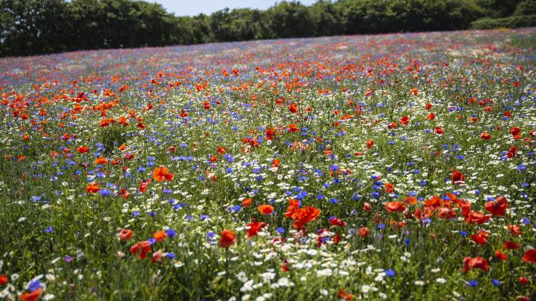
Paradise Pastures - An ‘Invisible World’

Slide 2
How does the Paradise Pastures Project Work?
For the first few sessions we will be completing the challenges set by the ‘Whatifs’ - developing our practical science skills and exploring the nature (biodiversity) in our school grounds.
After that you will come up with your own scientific question to investigate based on something that has interested you, decide how best to answer that question and then plan and complete an investigation to in order to answer your question.

Slide 3
We are the ‘Whatifs’. We enjoyed a peaceful, sleepy winter sheltered underneath the fallen leaves of autumn and have recently been enjoying the bright spring days. As we edge towards summer the plants here in Paradise Pastures have begun growing furiously in the longer, warm days. Life seemed like it couldn’t get better!
However, we have received warning through the ‘Wood Wide Web’, that the ‘Justsos’ have been getting their strimmer ready and that a dreaded ‘mowing’ is just around the corner. The ‘Justsos’ are only trying to keep things tidy, but the problem is that they tend it like everything around the place to look ‘Justso’. However, we know that if they left Paradise Pastures alone to grow more wild then that would be good for the plants, animals and fungi. As in - ‘Whatif they just left it alone?’
If only they could take a closer look! We need you to help us by helping them to see just how amazing and interesting our ‘Invisible World’ of Paradise Pastures is so that they can realise that the best way to help might actually be to let it grow a little wild!
Over the next few lessons we have 3 challenges for you to complete and 3 tinctures for you to drink, which we think will help you find out about the amazing Invisible world of Paradise Pastures. We have asked your teacher to draw a giant map of Paradise Pastures for you on the wall. This will come handy as a place for recording what you find out. Good luck!

Slide 4
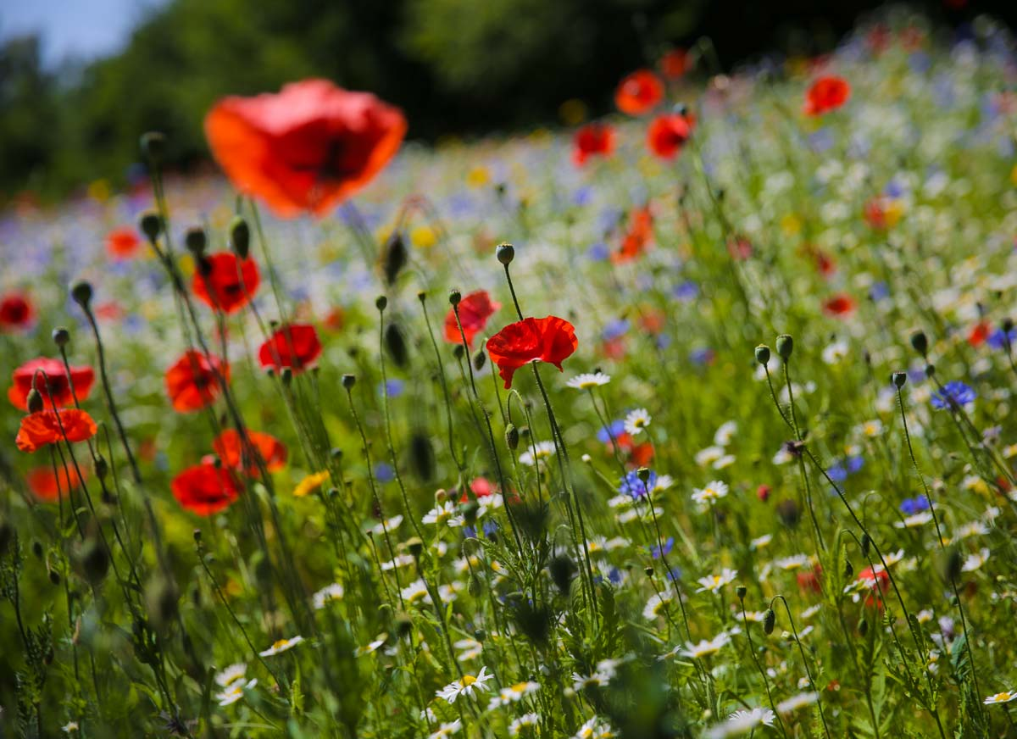
Outcomes for today’s lesson:
Use the internet to research what Paradise Pastures could become with a little help from the Justsos.
Describe some of the benefits of growing Wildflower Meadows and find out how to create one.

Slide 5
https://explorify.uk/en/activities/odd-one-out/friends-of-flowers

Slide 6
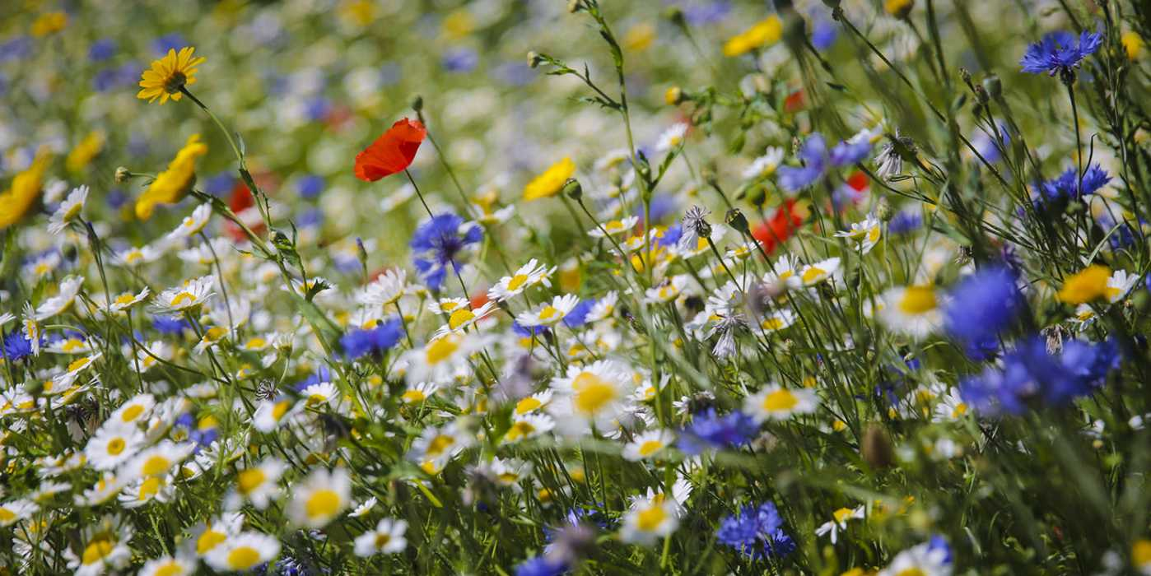
The Whatifs have sent you a photo that shows how the fields down the road from Paradise Pastures look when they are looked after for the benefit of nature and allowed to grow wild. They call this place ‘Wildflower Meadow’.
Notes:
https://www.edenprojectcommunities.com/stuff-to-do/seed-wildflower-meadow

Slide 7
Questions
1. Use the internet to find out why wild places like Wildflower Meadows are important for animals, plants, people and the wider environment.
2. Find out how to change a piece of grassland into a wildflower meadow without digging it up first (digging it up first takes a lot of time and effort)!
Notes:
https://www.edenprojectcommunities.com/stuff-to-do/seed-wildflower-meadow

Slide 8
www.edenproject.com/learn/for-everyone/how-to-create-a-wildflower-meadow-in-your-garden
www.edenproject.com/eden-story/our-ethos/national-wildflower-centre
https://plantlife.love-wildflowers.org.uk/wildflower_garden/how_to_grow_a_wildflower_meadow/
www.wildlifetrusts.org/actions/how-grow-wild-patch
www.kew.org/read-and-watch/meadows-matter
www.wildflower.co.uk/wildflower-advice/why-are-wildflowers-important#:~:text=Wildflowers%20provide%20pollinators%20and%20insects,beneficial%20during%20the%20winter%20also
www.nhm.ac.uk/discover/how-to-grow-a-better-lawn-for-wildlife.html

Slide 9
The Wood Wide Web
On 3 separate post-its record 3 pieces of information which you think would be important, useful or interesting to tell the Justsos about.

Slide 10
Outcomes for today’s lesson:
Use the internet to research what Paradise Pastures could become with a little help from the Justsos.
Describe some of the benefits of growing Wildflower Meadows and find out how to create one.

