Slide 1
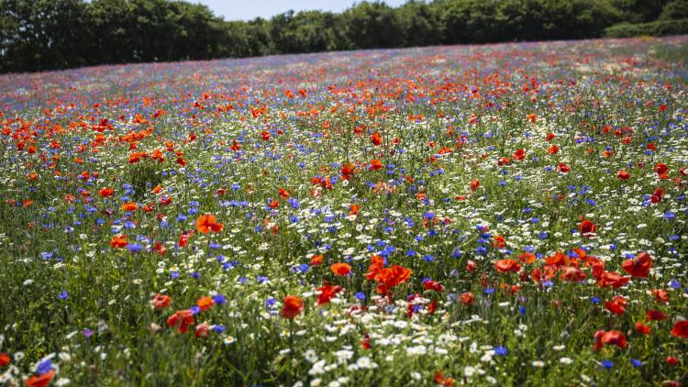
Paradise Pastures - An ‘Invisible World’

Slide 2
How does the Paradise Pastures Project Work?
For the first few sessions we will be completing the challenges set by the ‘Whatifs’ - developing our practical science skills and exploring the nature (biodiversity) in our school grounds.
After that you will come up with your own scientific question to investigate based on something that has interested you, decide how best to answer that question and then plan and complete an investigation to in order to answer your question.

Slide 3
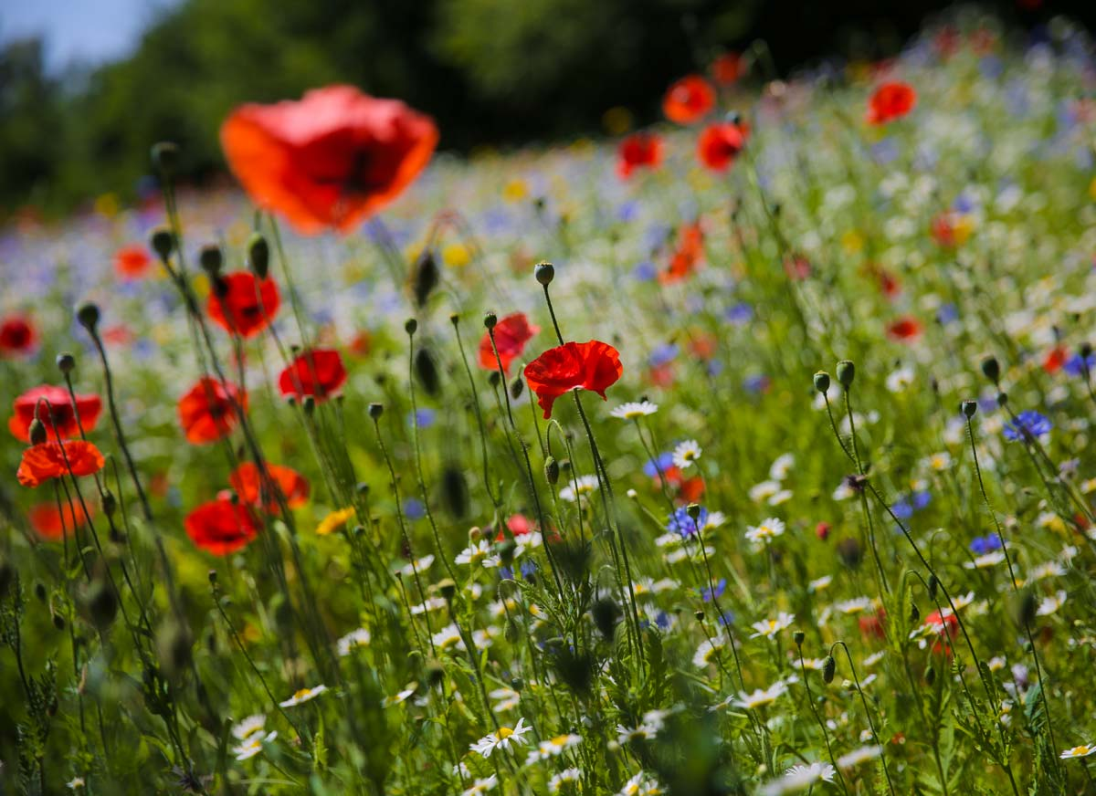
Outcomes for today’s lesson:
Agree upon your own scientific question to investigate
Suggest and discuss ways in which you could answer that question
Decide upon the most suitable method
Plan and complete the investigation

Slide 4
What makes a good scientific question to investigate?
A good scientific question:
Builds on something we have been learning about.
Matters to you – something you want to answer
Should give you a big clue (when you read it) about what it is you will be doing in order to answer it.

Slide 5
Possible questions
a. Could answer ourselves in the time we have.
c. Could answer by researching (e.g. online, books, asking an expert).
b. Could answer ourselves, but don’t have the time / resources/ equipment.

Slide 6
a. Could answer ourselves over the next few weeks in school
How does……..affect ……..
Does / Do……….
What happens……..
Is there a pattern between……….and…….
How……..
Which……
Where do….
Are…….

Slide 7
Ways of finding out………
©Primary Science Teaching Trust 2019
Notes:
https://pstt.org.uk/resources/curriculum-materials/enquiry-approaches

Slide 8
Outcomes for today’s lesson:
Agree upon your own scientific question to investigate
Suggest and discuss ways in which you could answer that question
Decide upon the most suitable method
Plan and complete the investigation

Slide 9
Possible questions…..
How do the plants in Paradise Pastures change throughout the year?
Are the types and numbers of invertebrates different throughout the year?
What is soil?
Is soil from one place in Paradise Pastures different from another place?
Do the plants grow more quickly in some parts of Paradise Pasture than others?
What kinds of flowers / plants do pollinators like the best?
How many different species of plant are there in Paradise Pastures?
How is a piece of grass different if it is mown? Never mown? Sometimes mown?
What environment do invertebrates (e.g. woodlice) prefer?
What conditions are best for plant growth?
Are the plants in the middle of the field different to those at the edges /by paths/by hedges/buildings?

