Slide 1
Climate Response
Your challenge today is to:
discuss ways in which individuals can respond confidently to the climate emergency.
describe how we can join together to demand that governments and organisations act to address the climate emergency.

Slide 2
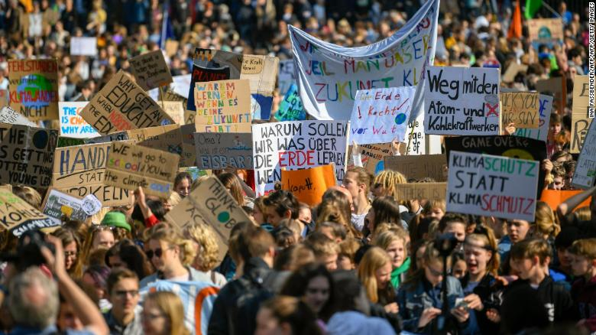
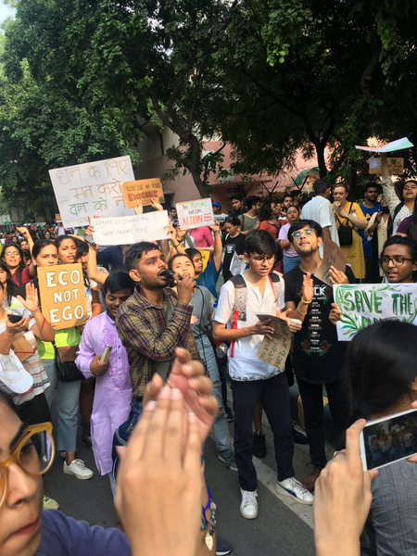
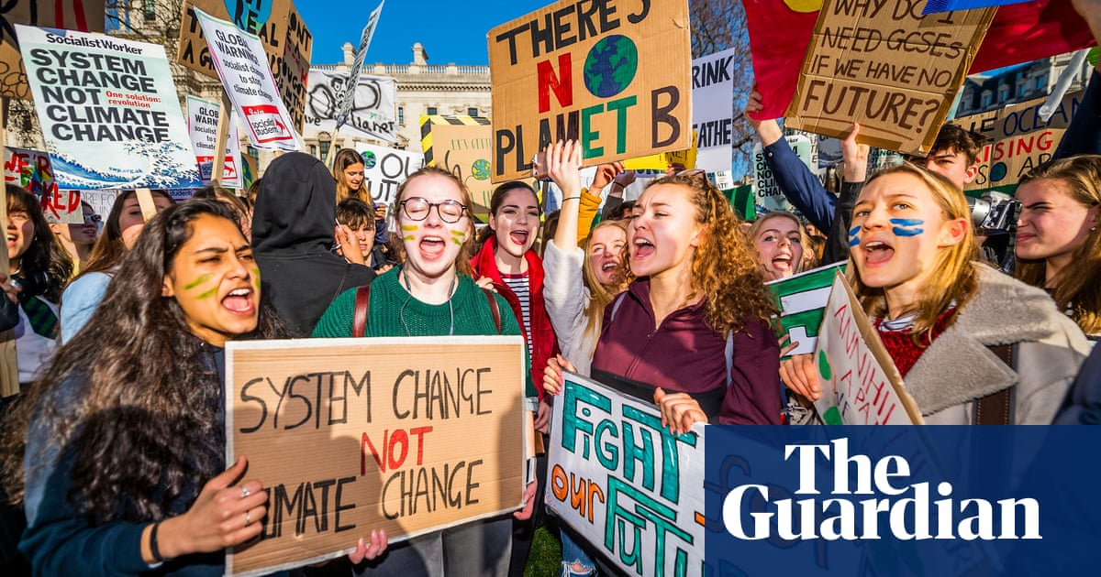
What are they photos of?
Where are they?
Who is involved?
Why are they doing it?
Notes:
https://www.theguardian.com/science/2019/mar/12/global-school-climate-strikes-share-your-videos-and-stories
https://edition.cnn.com/2019/05/24/world/global-climate-strike-school-students-protest-climate-change-intl/index.html
https://qz.com/india/1712995/the-global-climate-strike-inspires-protests-in-indias-cities/

Slide 3
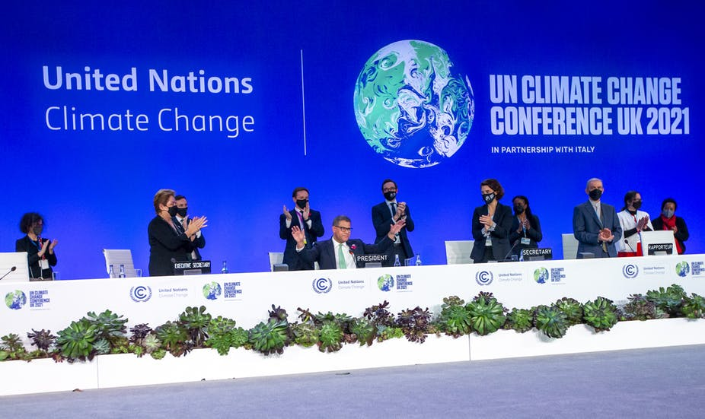
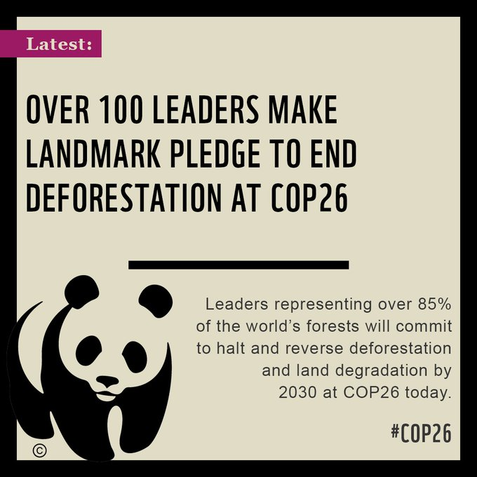

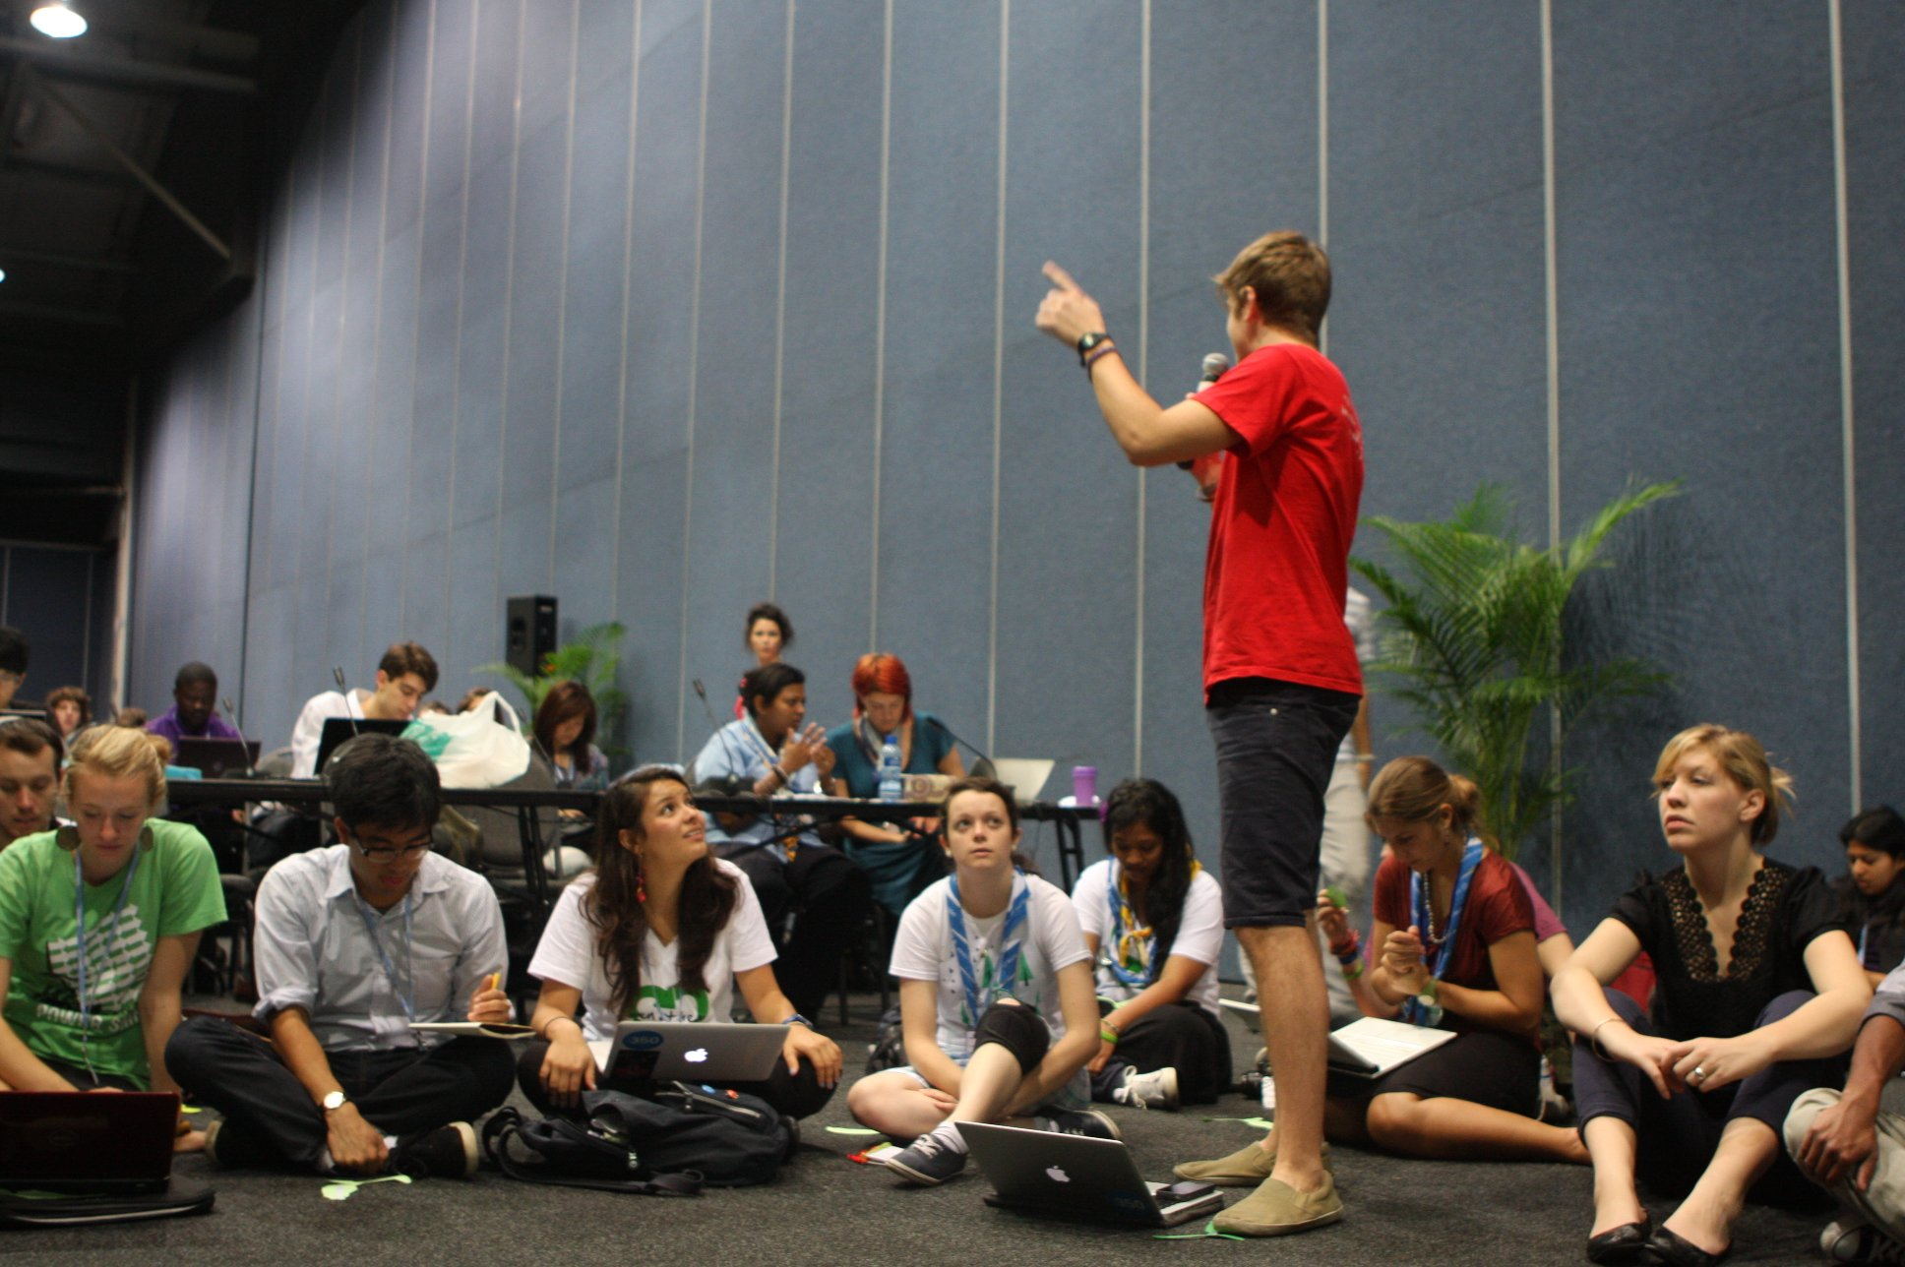
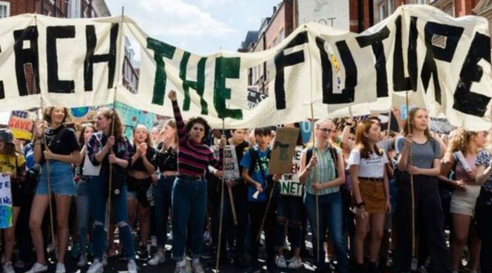
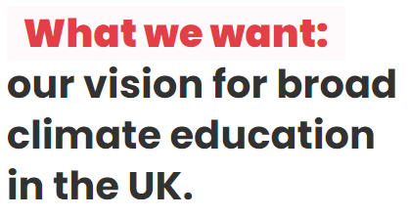

Notes:
https://theconversation.com/cop26-experts-react-to-the-un-climate-summit-and-glasgow-pact-171753
https://www.ukcop26.org/
https://twitter.com/wwf/status/1455454418187571203?lang=bn
https://www.theccc.org.uk/2020/06/25/covid-19-can-be-an-historic-turning-point-in-tackling-the-global-climate-crisis/
https://ukcoy16.org/
https://www.teachthefuture.uk/
https://www.teachingtimes.com/teach-the-future/

Slide 4
Why is the climate changing?

Slide 5
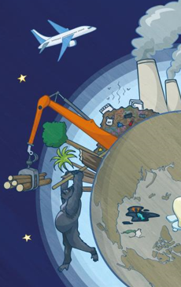
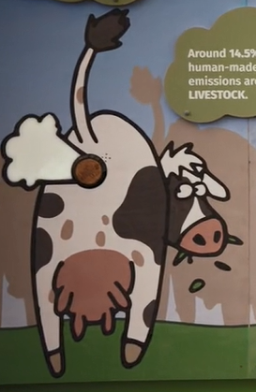
Things that put carbon dioxide and other greenhouse gases into the atmosphere?
Making electricity in fossil fuel power stations
Transport – planes, car, ships and lorries
Making stuff in factories
Deforestation
Landfill produces methane
Livestock produce methane
Notes:
www.edenproject.com

Slide 6
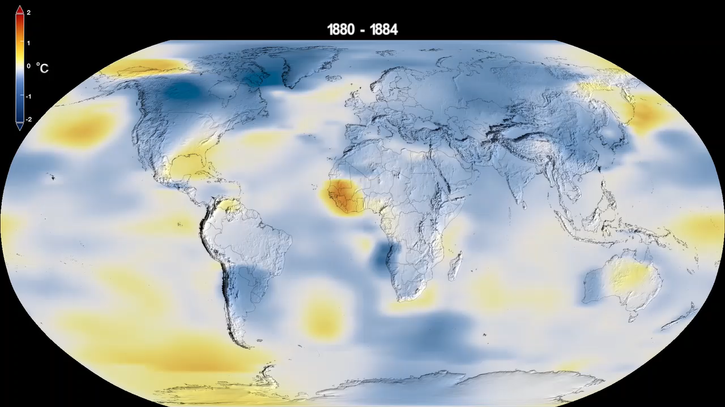
This NASA animation shows the changes in global temperatures since 1880. Higher than normal temperatures are shown in red and lower than normal temperatures are shown in blue. What do you notice?
Notes:
https://svs.gsfc.nasa.gov/4882

Slide 7
Being part of the solution
Doers
Shoppers
Learners
Shouters

Slide 8
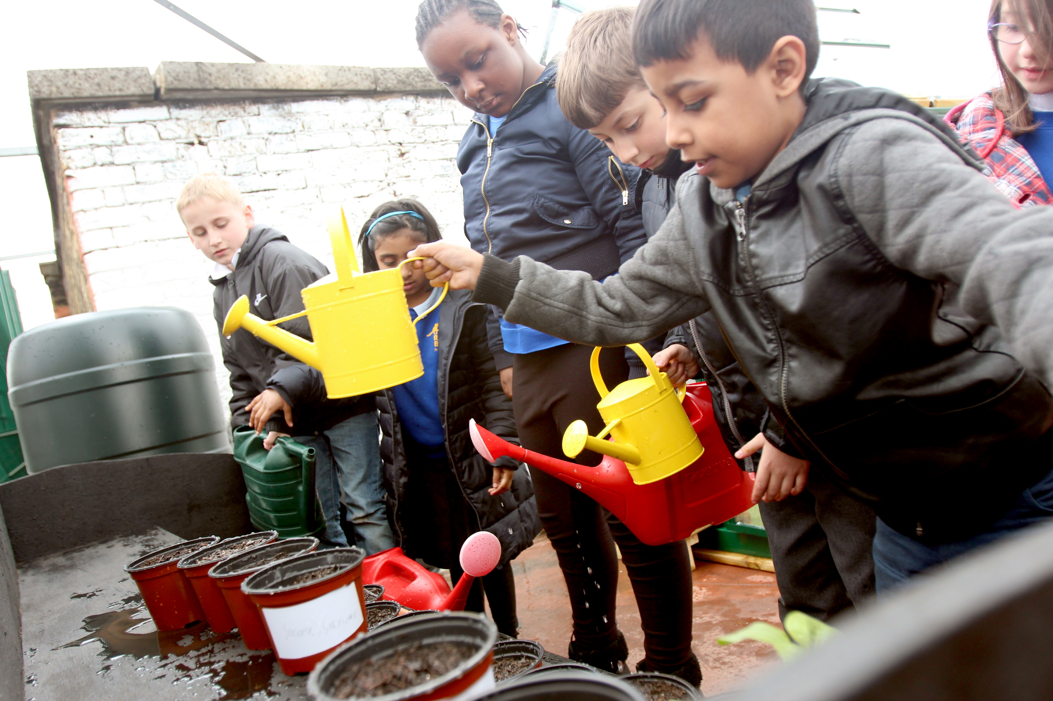

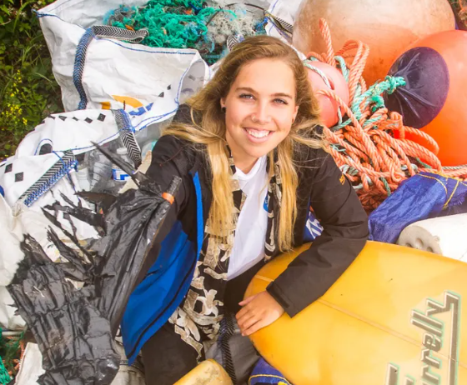


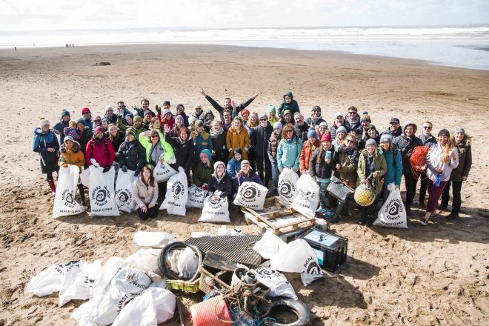
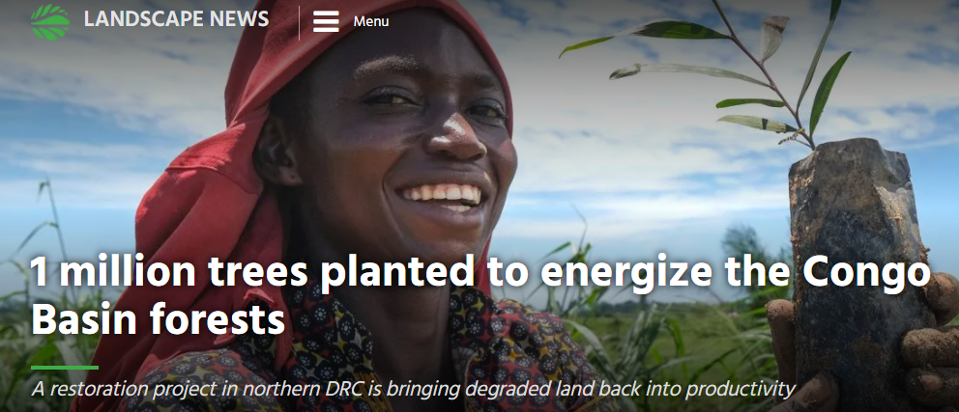
Doers – hands on stuff
27 March, 2022
climatevisuals.org Credit: 10:10 /
April, 2021
Notes:
https://www.theguardian.com/environment/2022/mar/27/pick-up-the-pieces-cornwalls-beach-cleaners-tackling-plastic-pollution
https://news.globallandscapesforum.org/51923/1-million-trees-planted-to-energize-the-congo-basin-forests/
https://climatevisuals.org/search/?searchQuery=gardening (1067)
https://www.sas.org.uk/news/45700-volunteers-join-the-biggest-ever-uk-beach-clean/

Slide 9
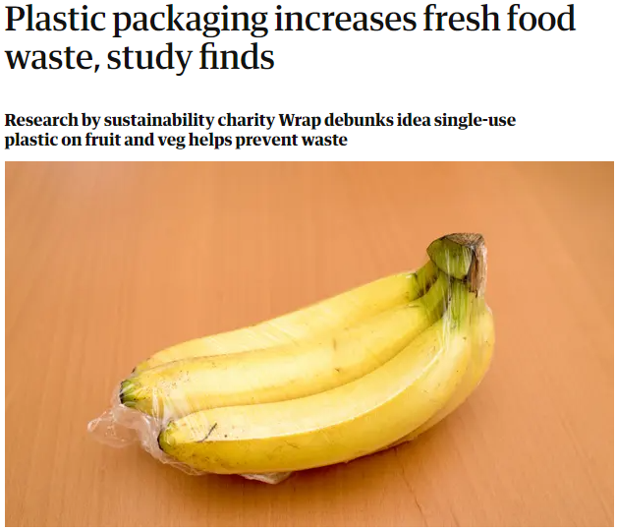

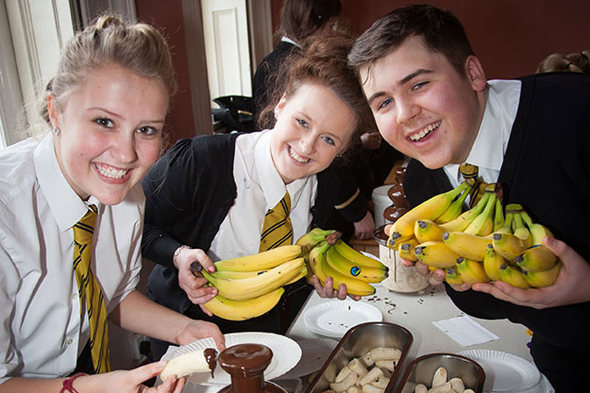


Shoppers – choices when you buy stuff
24 February, 2022
Notes:
https://www.rainforest-alliance.org/faqs/what-does-rainforest-alliance-certified-mean
https://www.theguardian.com/environment/2022/feb/24/plastic-packaging-increases-fresh-food-waste-study-finds
https://schools.fairtrade.org.uk/fairtrade-schools-awards/
https://octopus.energy/

Slide 10
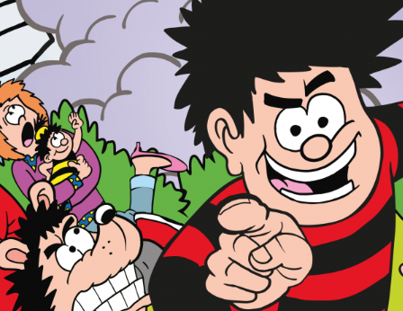
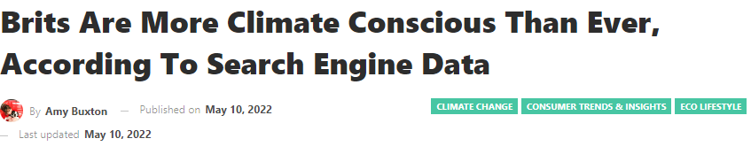


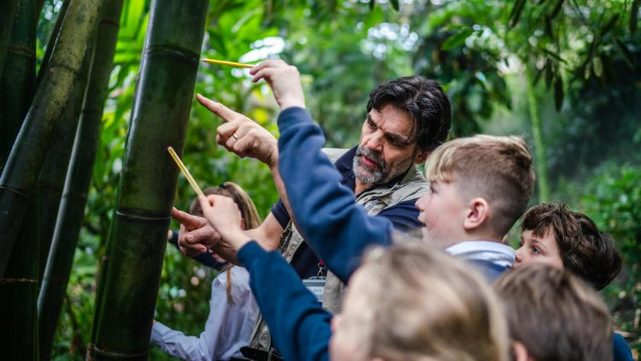

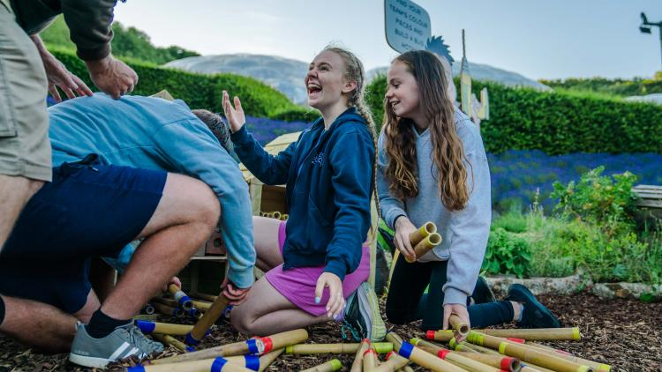
Learners – seeking knowledge and staying informed
Over 40,000 school children visit Eden Project each year !
Notes:
https://www.greenqueen.com.hk/uk-climate-conscious-search-data/
https://www.edenproject.com/learn/schools
https://www.edenproject.com/visit/whats-on/go-wild-with-beano-at-eden

Slide 11
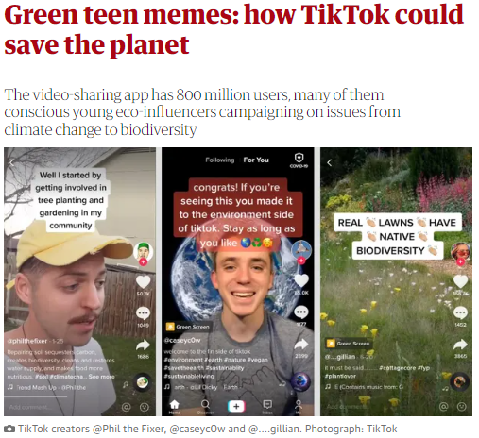
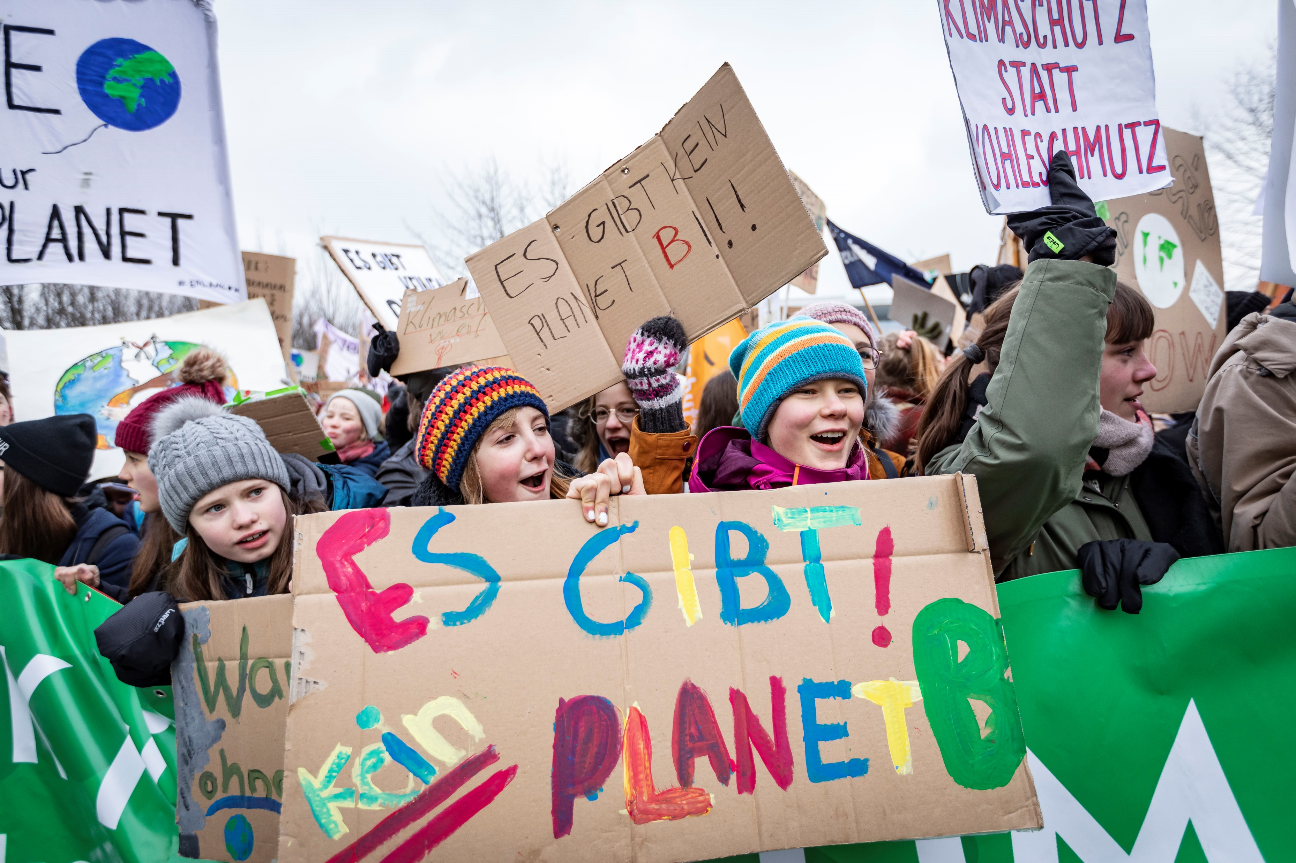
Shouters – sharing what you care about
Climatevisuals.org Credit: Jörg Farys / Fridays for Future
Notes:
https://www.theguardian.com/environment/2020/aug/28/green-teen-memes-how-tiktok-could-save-the-planet-aoe
https://climatevisuals.org/search/?searchQuery=1171

Slide 12
What sort of person do you think you are (mainly)?
Doers – hands on stuff
Shoppers – choices when you buy stuff
Learners – seeking knowledge
Shouters – sharing what you care about

Slide 13

Finally: Can an individual really have an impact?
If I eat less meat, buy local food, ride my bike, buy less “stuff”, recycle more, waste less food, talk to people about the planet…
…does it really make any difference?
YES!

Slide 14
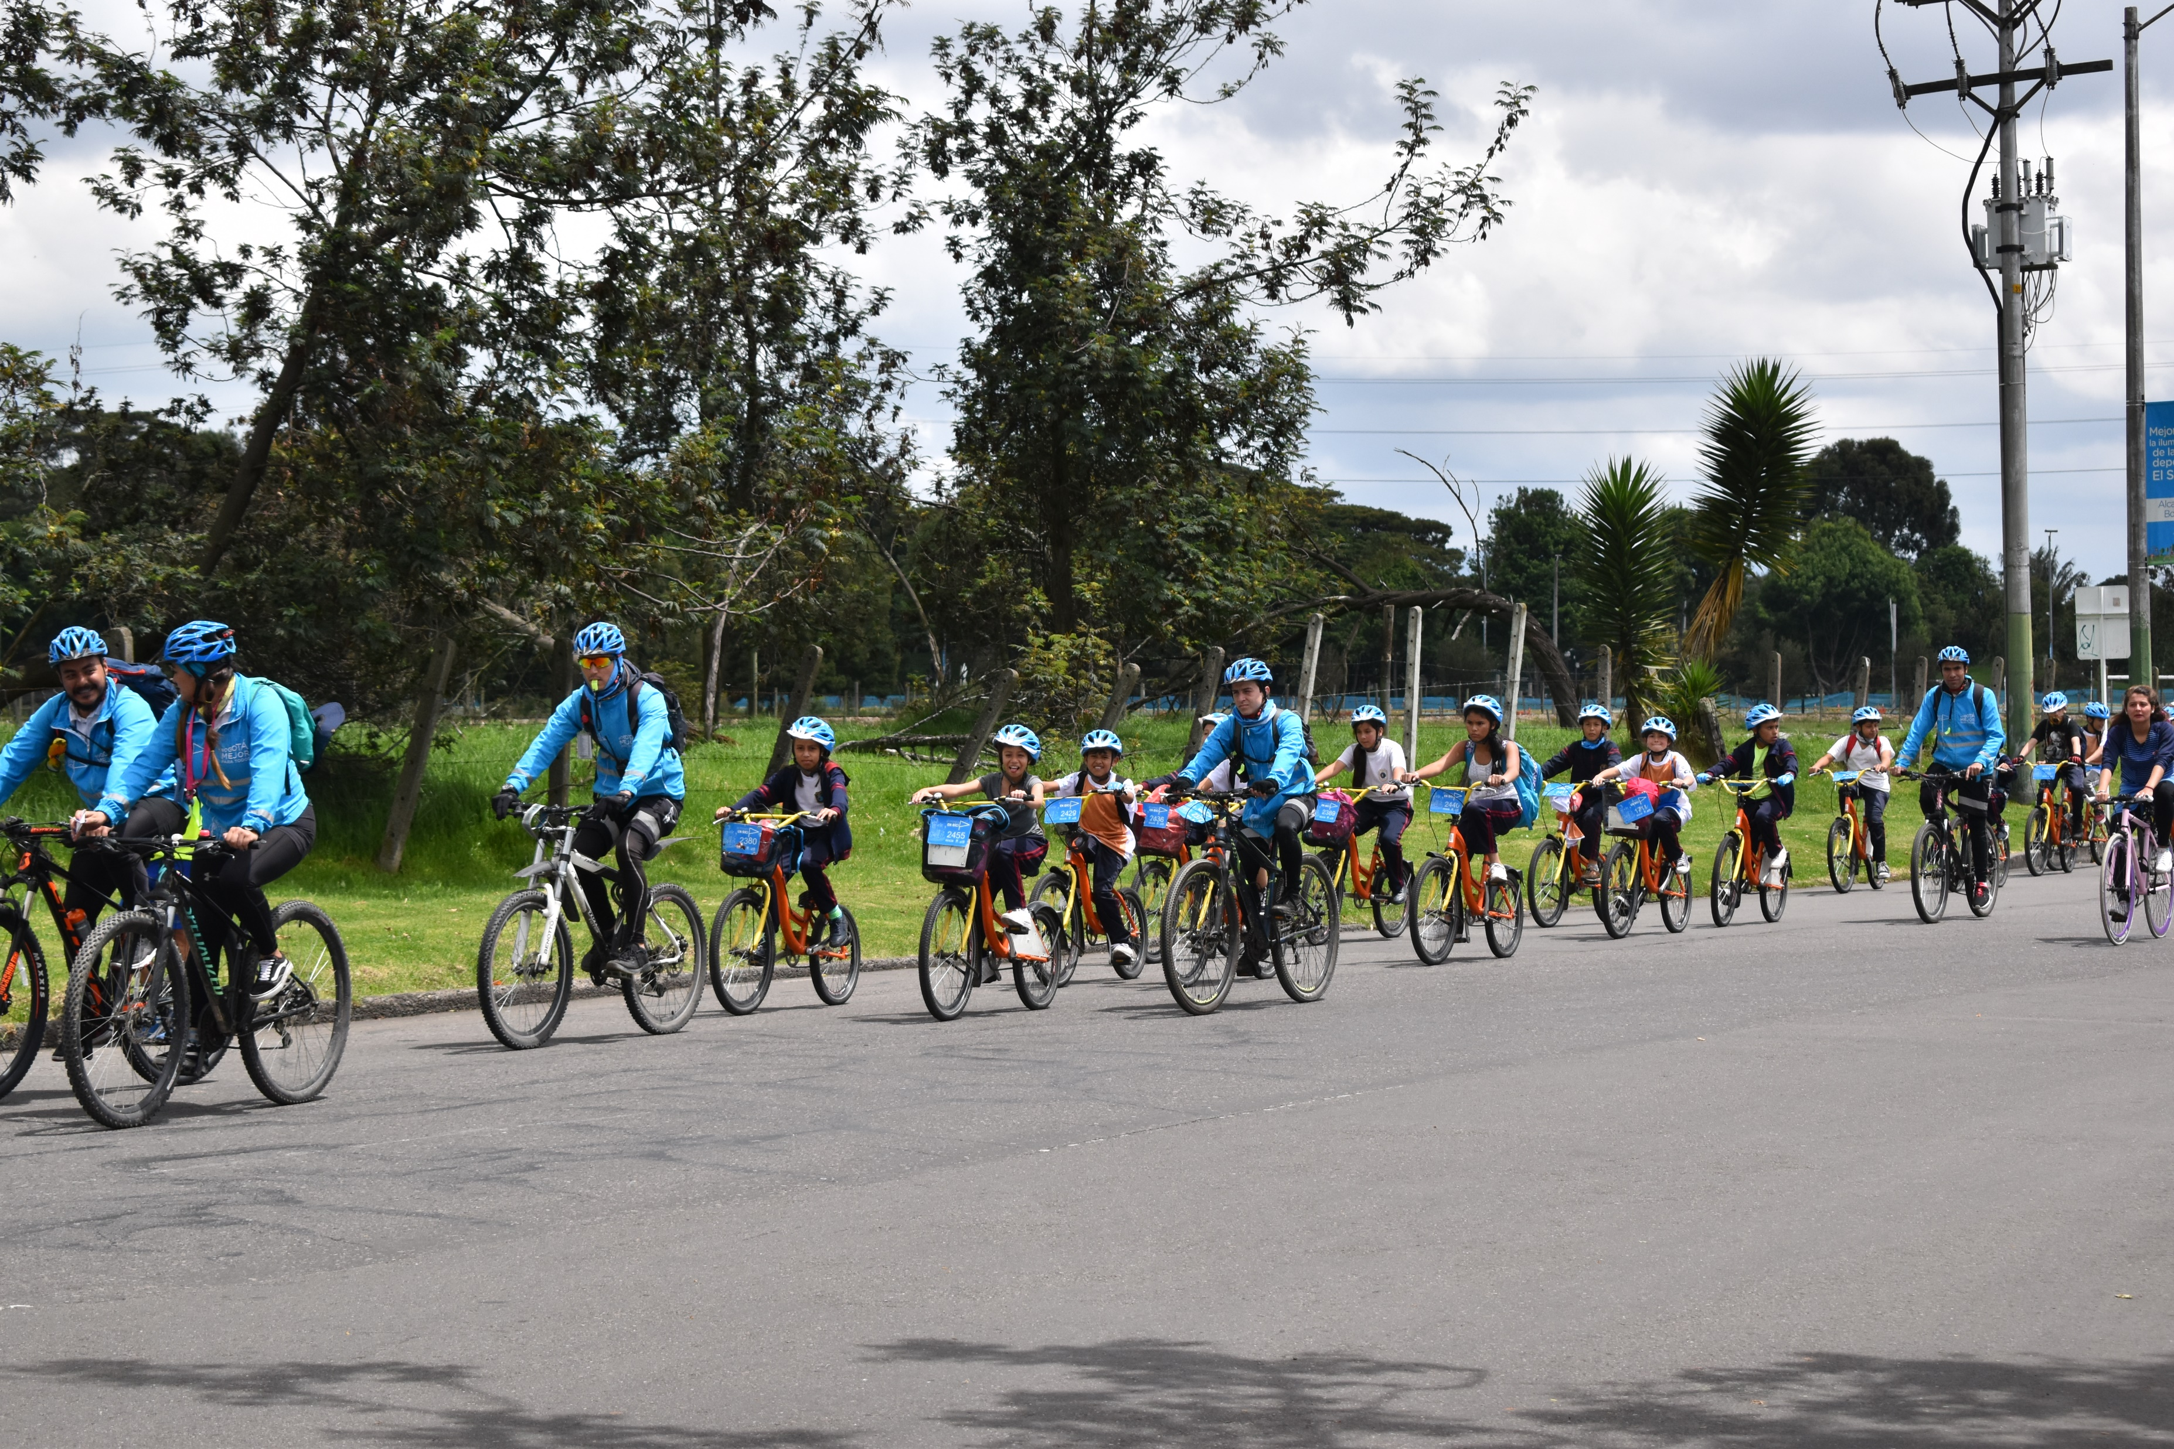
Finally: Can an individual really have an impact?
YES!
Your actions matter.
Your own actions will reduce your personal carbon dioxide emissions.
We influence each other – when one person makes a decision to help the environment, other people notice and join in.
climatevisual.org Credit: Ashden / Ashden
Notes:
https://www.bbc.com/future/article/20181102-what-can-i-do-about-climate-change
https://climatevisuals.org/search/?searchQuery=transport 1428

Slide 15
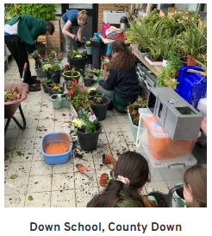
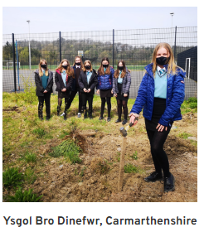

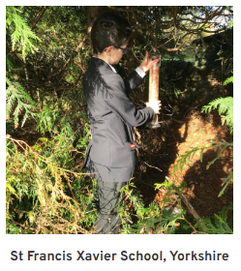
letsgozero.org/
Notes:
https://letsgozero.org/
https://schools.fairtrade.org.uk/take-action/join-uk-schools-taking-on-climate-change/

Slide 16

Climate Response
Your challenge today is to:
discuss ways in which individuals can respond confidently to the climate emergency.
describe how we can join together to demand that governments and organisations act to address the climate emergency.
youtube.com/watch?v=fW8amMCVAJQ
Eden Project would be keen to know about ways in which you decide to take action. Please share via twitter @edenschoolsteam #makethechange

