Slide 1
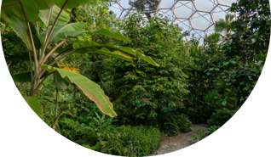
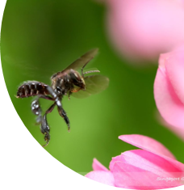
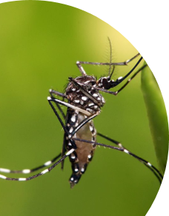
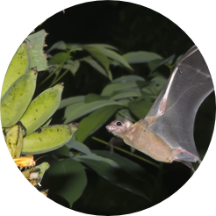
Rainforest
Super Senses

Slide 2
Your challenge is to become ‘Rainforest Supersensers'!​
To do that you will need to:​
Find some of the world’s Tropical Rainforests on the map and say what it's like there.​
Name 3 animals from the Tropical Rainforest and the plant which they are linked to.​
Describe the 3 unusual ‘super senses’ that these animals have and find out how each ‘super sense’ helps the animal to find its food.

Slide 3
Getting Started
Time to tune into our own senses!
We use our senses to find out what the world around us is like!

Slide 4
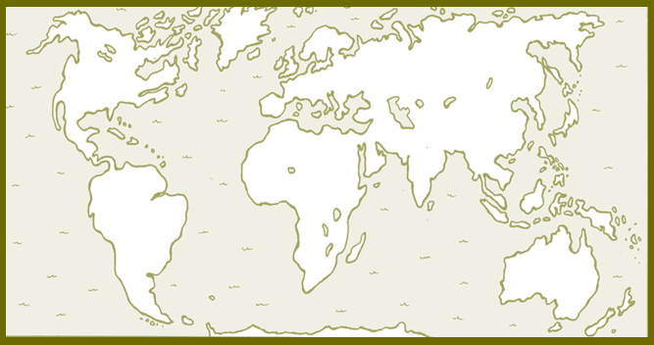
Where do we find Tropical Rainforests and what is it like there?​

Slide 5
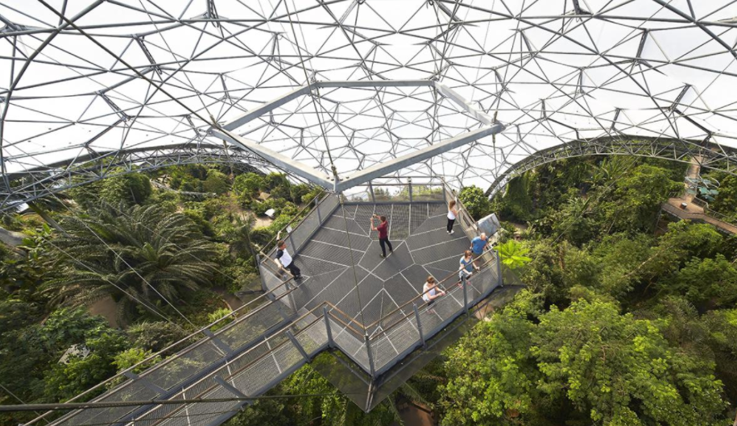
Invisible Rainforest

Slide 6
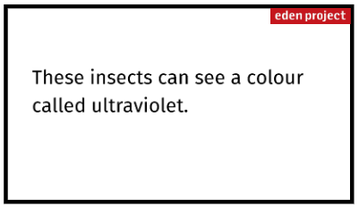
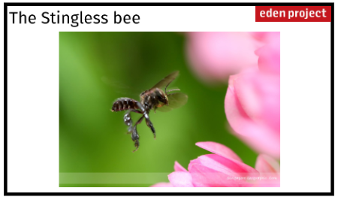
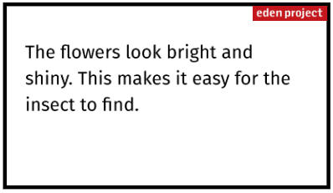

Slide 7
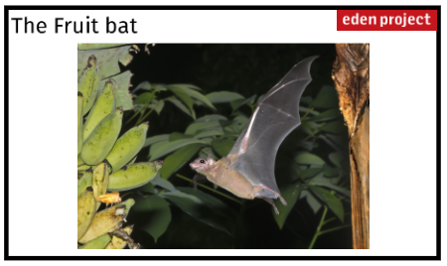
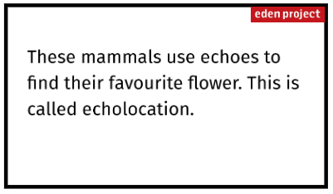
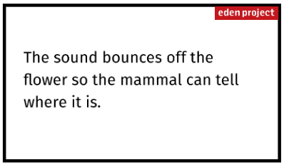

Slide 8
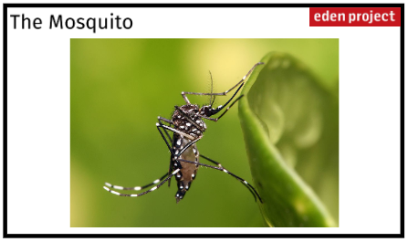
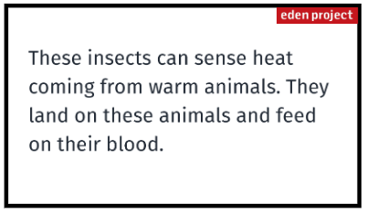
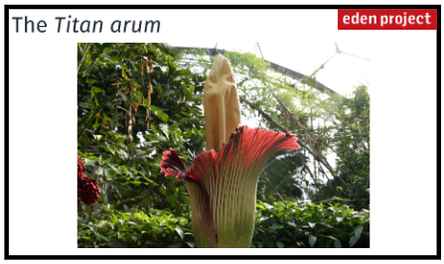

Slide 9
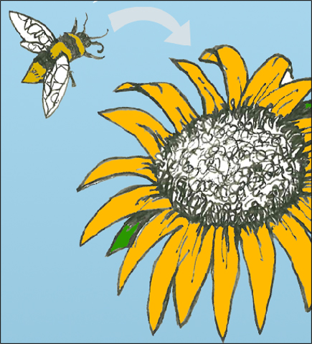
Pollination
The bee is attracted to the pretty flower

Slide 10
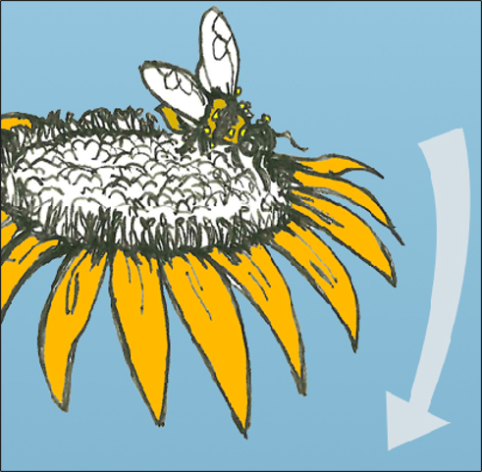
Pollen sticks to the bee

Slide 11
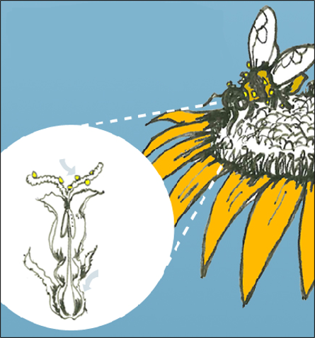
The bee then flies off to another flower and takes the pollen with it.
Pollen enters the flower here
Then turns into seeds here

Slide 12
Your challenge is to become ‘Rainforest Supersensers'!​
To do that you will need to:​
Find some of the world’s Tropical Rainforests on the map and say what it's like there.​
Name 3 animals from the Tropical Rainforest and the plant which they are linked to.​
Describe the 3 unusual ‘super senses’ that these animals have and find out how each ‘super sense’ helps the animal to find its food.

Slide 13
Rainforest
Super Senses

