Slide 1
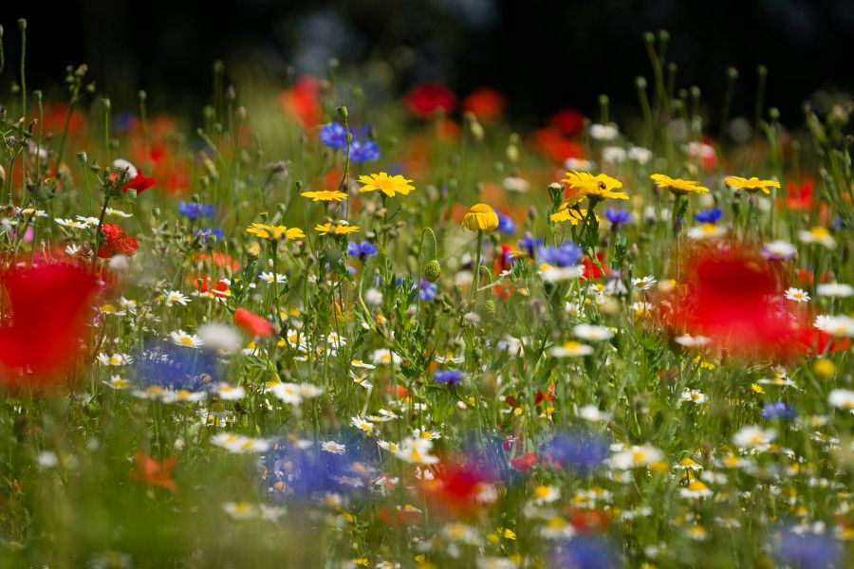
‘Sow for Success’

Slide 2
I wandered lonely as a cloud
That floats on high o'er vales and hills,
When all at once I saw a crowd,
A host, of golden daffodils;
Beside the lake, beneath the trees,
Fluttering and dancing in the breeze.
William Wordsworth 1804
This verse is probably one of, if not the most famous opening stanzas in the history of British poetry. It was written by the English poet William Wordsworth in 1804. He was inspired by a walk he took, with his sister, through the countryside. However, since the time it was written, the ‘host of golden daffodils’ that inspired this famous poem (along with many other species of native wildflowers) are a far less common sight in the British countryside.

Slide 3
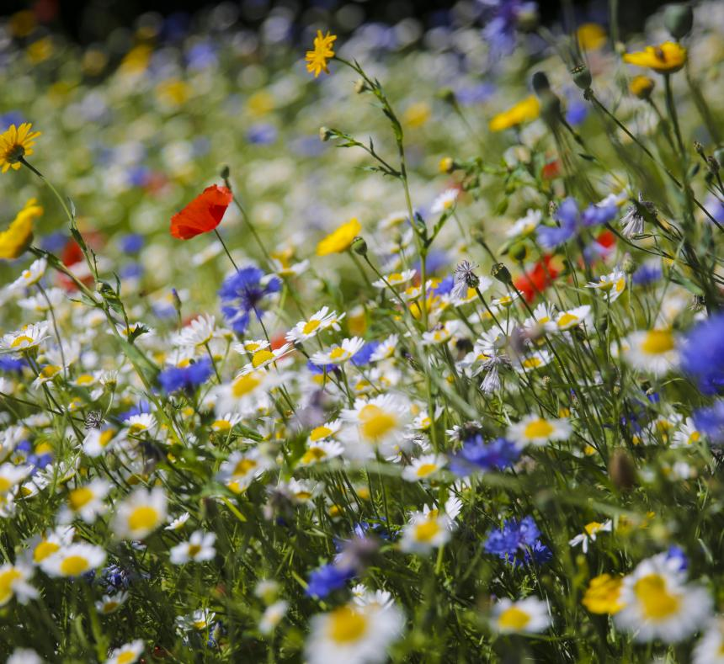
Outcomes for today’s lesson:
Understand the cause and effect of changes to the British countryside, brought about by WW2.
Describe the link between wildflowers, pollinators and food.
Explain how sowing wildflowers can contribute to the health and well-being of UK habitats and help to ensure food security for the future.

Slide 4
A brief history of Wildflowers in Britain, since 1930
In 1930, natural wildflower meadows could be seen across the British countryside. There were over 7.5 million acres of wildflower meadows across the nation. That’s about the same size as 3,750,000 football pitches!
During the Second World War (1939-1945) over 6 million acres of grassland (approximately 3 million football pitches) was ploughed to grow cereals and vegetables.
Over the 40 years that followed, 97% of the wild flower meadows, that were once a common sight across the country were destroyed.
Today, wildflower meadows account for less than 1% of the British countryside.
Information source: Save our magnificent meadows website
Notes:
http://www.magnificentmeadows.org.uk/conserve-restore/importance-of-meadows#:~:text=Six%20million%20acres%20of%20grassland,albeit%20marginally%20less%20catastrophic%2C%20fate.

Slide 5
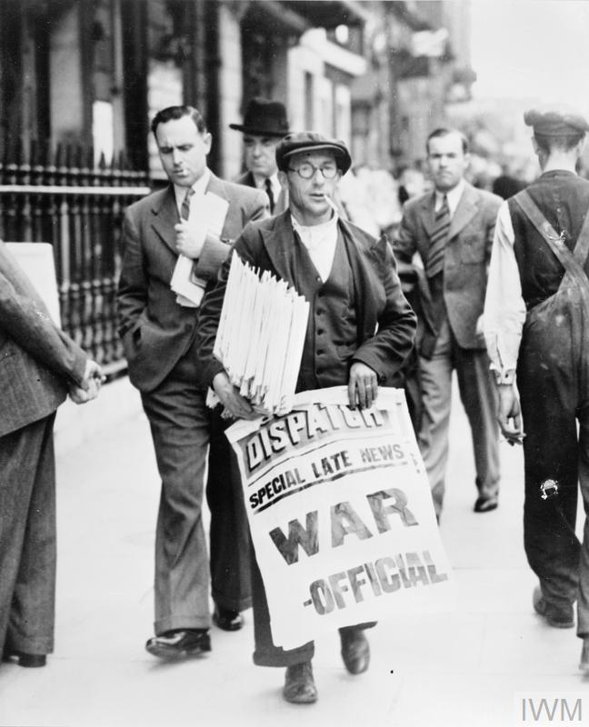
So, why did WW2 cause the destruction of Wildflower meadows?
The start of World War II (in 1939) led to major food security issues across Britain. People struggled to get hold of the foods that they were used to eating and, in turn, were struggled to feed their families.
Like today, much of the food consumed in Britain before the war, was produced overseas and imported (on ships) to this country. When the Second World War started the ships carrying food supplies became vulnerable to enemy attack. So, far less food was reaching Britain.
The transportation of military hardware also meant there was less shipping capacity available for food.
© IWM HU 36171
Information source: Imperial War Museum website
Notes:
Image from: https://www.iwm.org.uk/collections/item/object/205070060

Slide 6
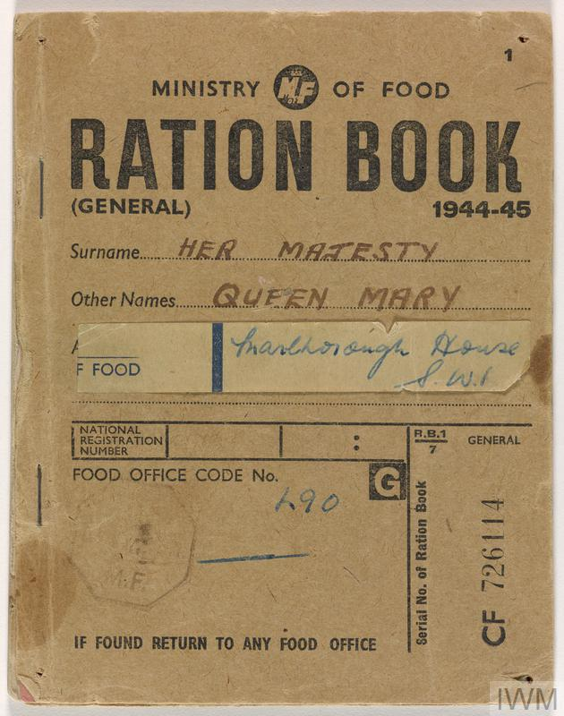
Rationing was introduced…
In January 1940, the British government introduced food rationing. The scheme was designed to ensure fair shares of those foods which were in short supply due to the war. Rationing was overseen by the Ministry of Food which issued every man, woman and child a ration book with coupons. These restricted how much of each rationed food could be purchased each week.
Basic foodstuffs such as sugar, meat, fats (like butter and margarine), bacon and cheese were rationed by the coupons in the ration book.
Some foods such as fish or sausages were not rationed but could be in short supply which led to long hours of queuing, and sometimes disappointment when upon reaching the front of the queue it was only to discover that what you were queuing for had sold out.
© IWM Documents.24347/A
Information source: Imperial War Museum website
Notes:
Image from: https://www.iwm.org.uk/collections/item/object/1030045897

Slide 7
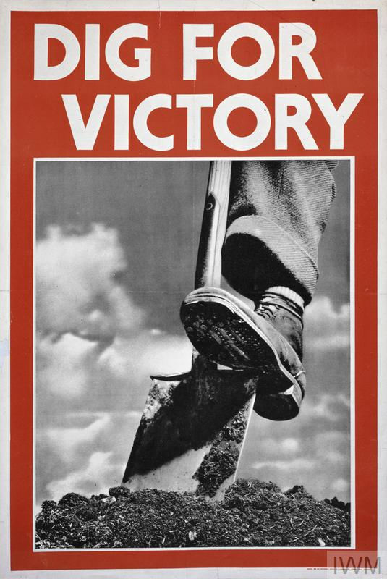
The Dig for Victory campaign…
To help with food shortages, The Ministry of Agriculture also introduced the Dig for Victory campaign. This encouraged people to use any available space that they could find to grow food to help feed themselves and their communities during the war effort.
Click on the picture below to see the Dig for Victory campaign video (from the Imperial War Museum).
© IWM UKY 319
© IWM Art.IWM PST 0059
Notes:
Image from: https://www.iwm.org.uk/collections/item/object/27692
Video link: https://www.iwm.org.uk/collections/item/object/1060006259

Slide 8
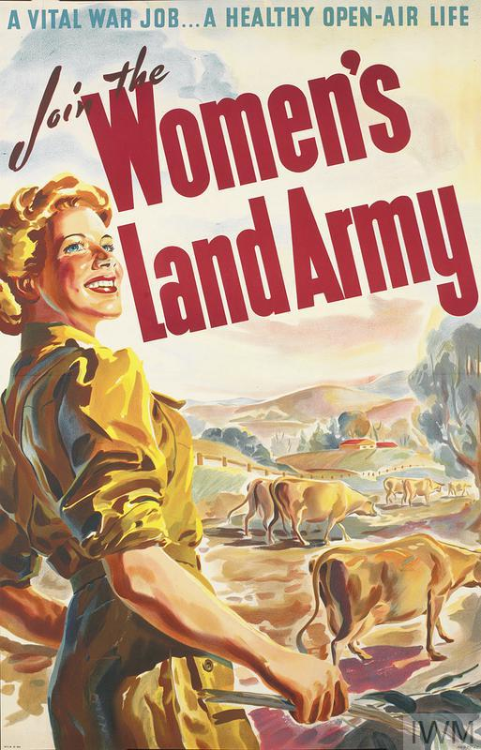
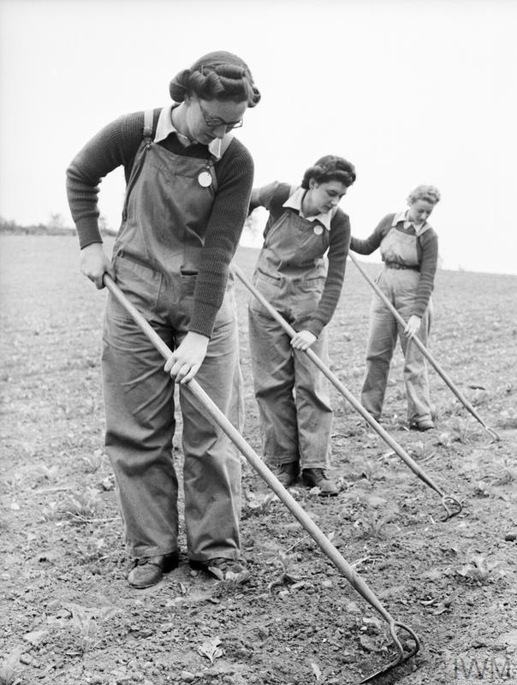
The Woman’s Land Army…
As well as encouraging people to grow their own food, The Women’s Land Army (WLA) was formed in the summer of 1939. Women of all ages joined up, and were later conscripted, to help farm the British countryside.
By the end of the war, 80,000 land girls were working on farms across the UK.
These women undertook all aspects of farm work, including livestock handling, dairy, flax growing (for clothing), hedging, vegetable growing, ploughing and threshing.
© IWM Art.IWM PST 16615
© IWM D 8826
Notes:
Poster from: https://www.iwm.org.uk/collections/item/object/33508
Photograph from: https://www.iwm.org.uk/collections/item/object/205199386

Slide 9
So, back to our original question: Why did WW2 cause the destruction of Wildflower meadows?
© IWM Documents.24347/A
© IWM Art.IWM PST 0059
© IWM Art.IWM PST 16615
Even though all of these efforts were crucial at the time, it is suggested that WW2 played a significant role in accelerating a change in farming, that has led to the destruction of nearly all of Great Britain’s wildflower meadows.
Notes:
Ration Book image from: https://www.iwm.org.uk/collections/item/object/1030045897
Dig for Victory image from: https://www.iwm.org.uk/collections/item/object/27692
Women’s Land Army image from: https://www.iwm.org.uk/collections/item/object/33508

Slide 10
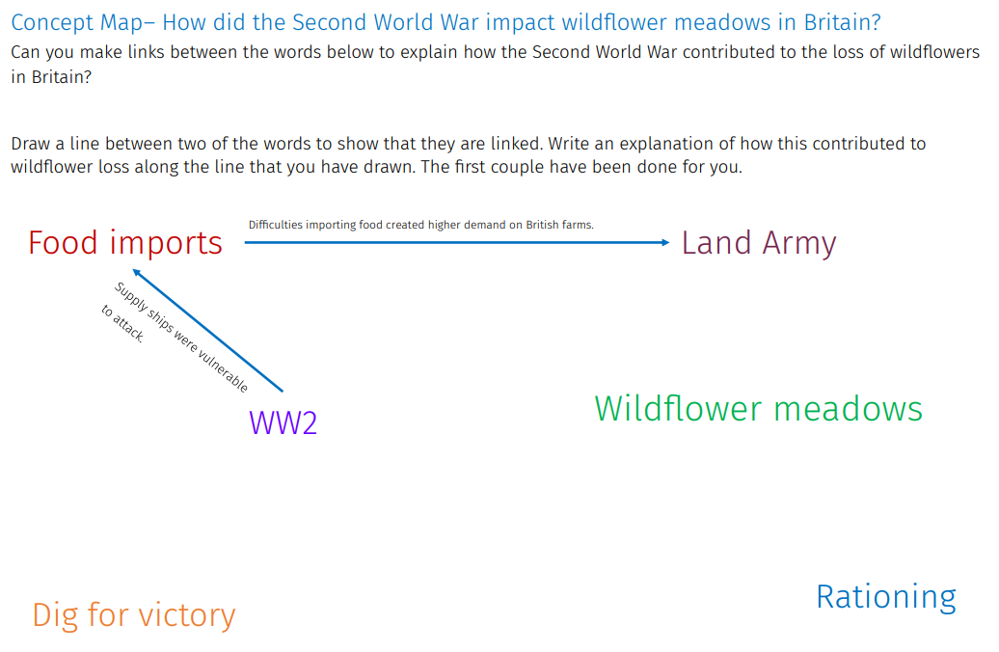
Activity 1
Fill in this concept map to show that you understand the causes of wildflower loss that are related to the Second World War.

Slide 11
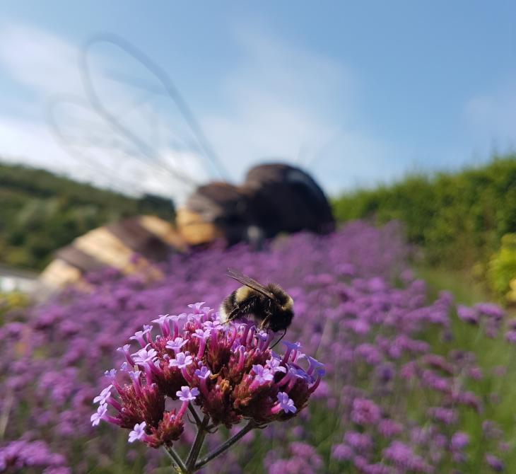
But why are wildflower meadows important?
There are many advantages to planting wildflowers. These include:
Connecting people with the natural world.
Transforming underused spaces into vibrant living landscapes.
Increasing biodiversity.
Help pollinators that are currently under threat.
Pollinators, such as bees, hoverflies, butterflies, moths, beetles and wasps play a crucial role for UK food security. According to the ‘Our World Data’ website, 75% of the different crops we grow for food depend on pollinators to some extent.
However, the number of pollinators we have (in the UK and around the world) has dropped dramatically over the past ten years. This would have a significant impact on the food we are able to grow and eat!

Slide 12
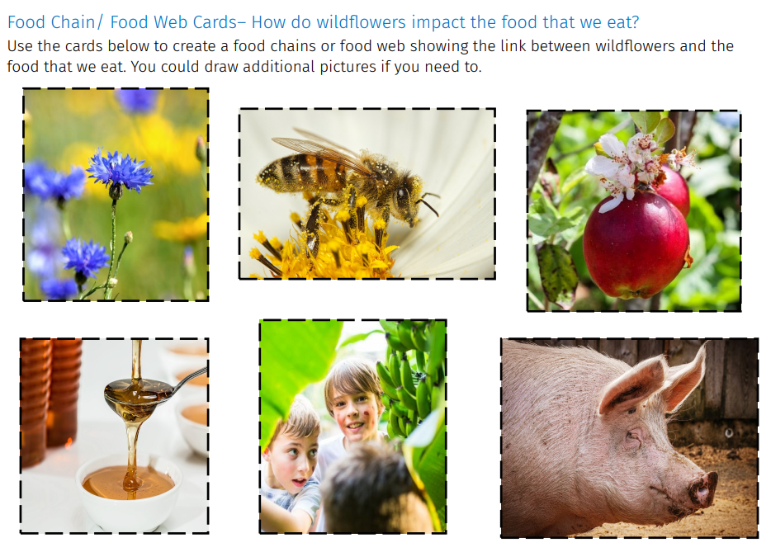
Activity 2
Use the cards below to create food chains or food webs showing the link between wildflowers and the food that we eat.

Slide 13
So what can you do to help?
Main Activity
Challenge:
We want you to embark on a ‘Dig for Victory’ style campaign to encourage people within your community to find available areas to sow wild flowers. We are calling this ‘Sow for Success!’
You could:
Lead by example, finding creative ways to sow areas of wildflowers around your school.
Create posters, in the style of the WW2 campaign you have seen today, to encourage other people to do the same.
Produce campaign videos inspired by the Dig for Victory video from the Ministry of Information (see Slide 7).
Write letters to influential people in your local area to persuade them of the importance of sowing wildflowers in your community.
Sow for Success
© IWM Art.IWM PST 0059
Notes:
Image from: https://www.iwm.org.uk/collections/item/object/27692

