Slide 1
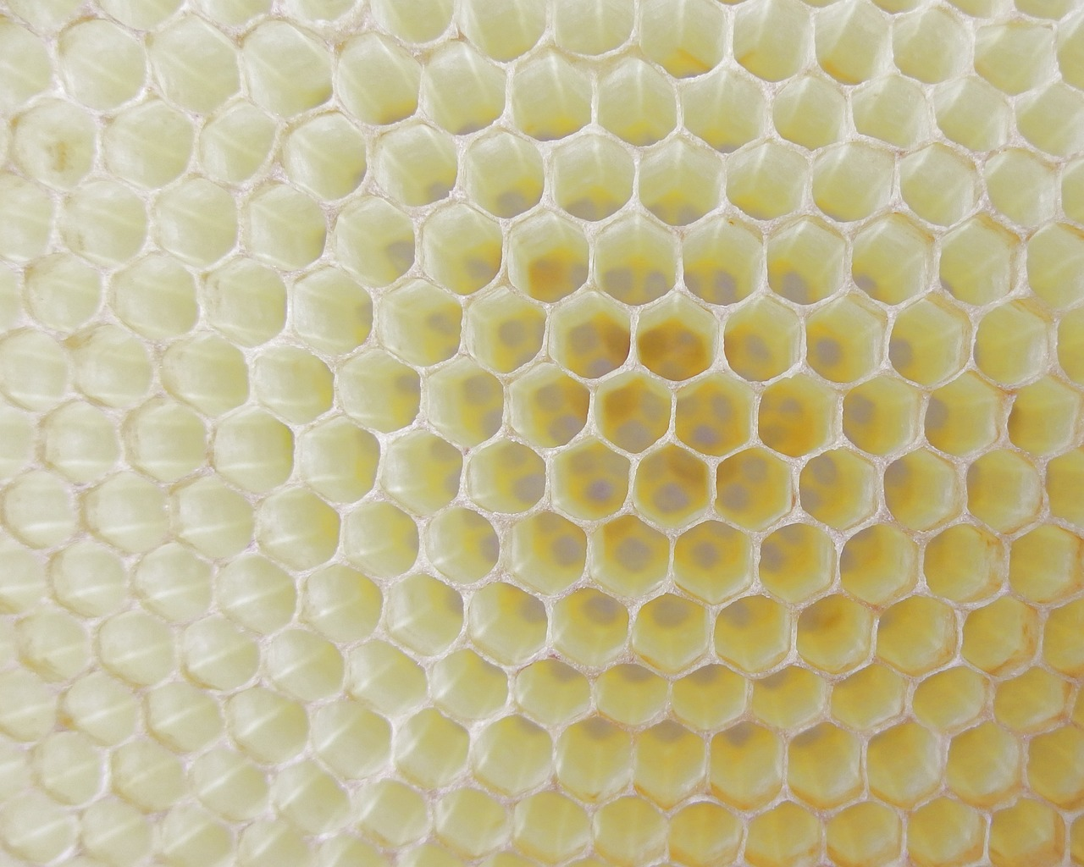

The Littlest Bee
Author: Thomas Last

Slide 2
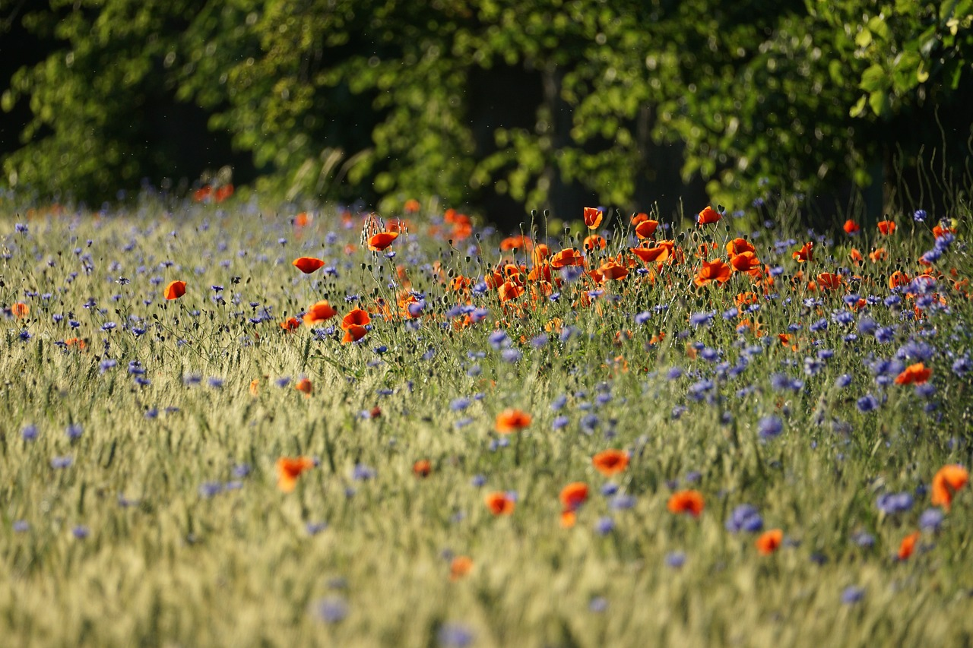
In the wildflower meadow, where this story is set…

Slide 3
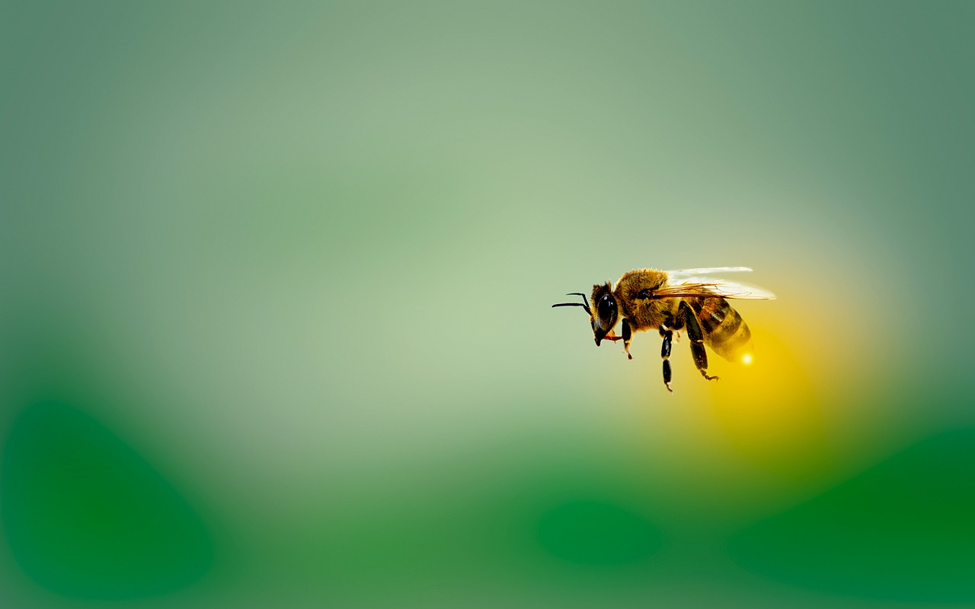
Lived a small little bee, whose name was Collette.

Slide 4
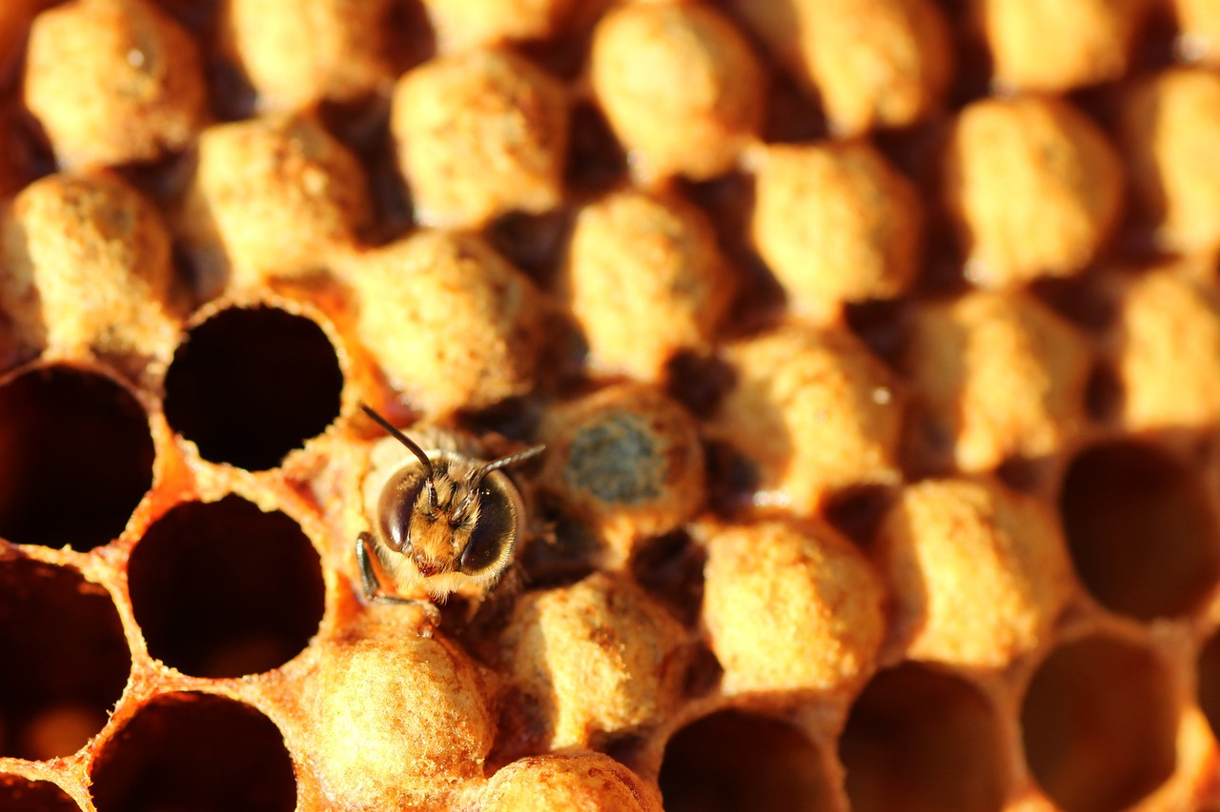
From the second she hatched, on the day she was born…
Collette was much smaller, than the rest of her swarm.

Slide 5
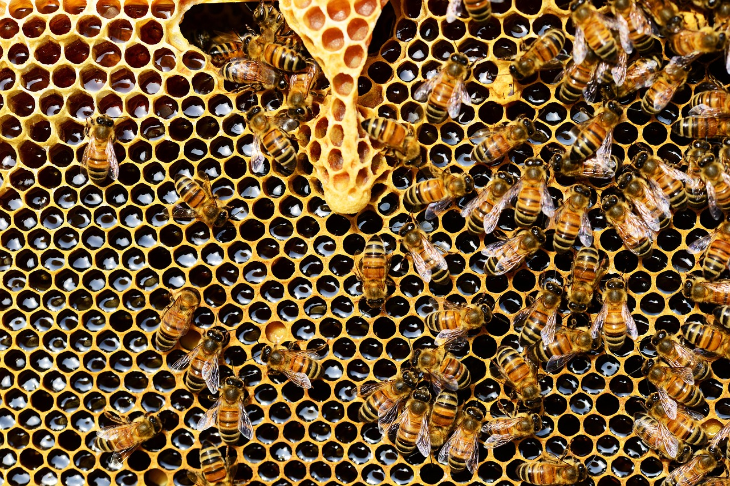
Her brothers and sisters all thought it was funny…
“You couldn’t grow if you ate ALL of the honey”

Slide 6
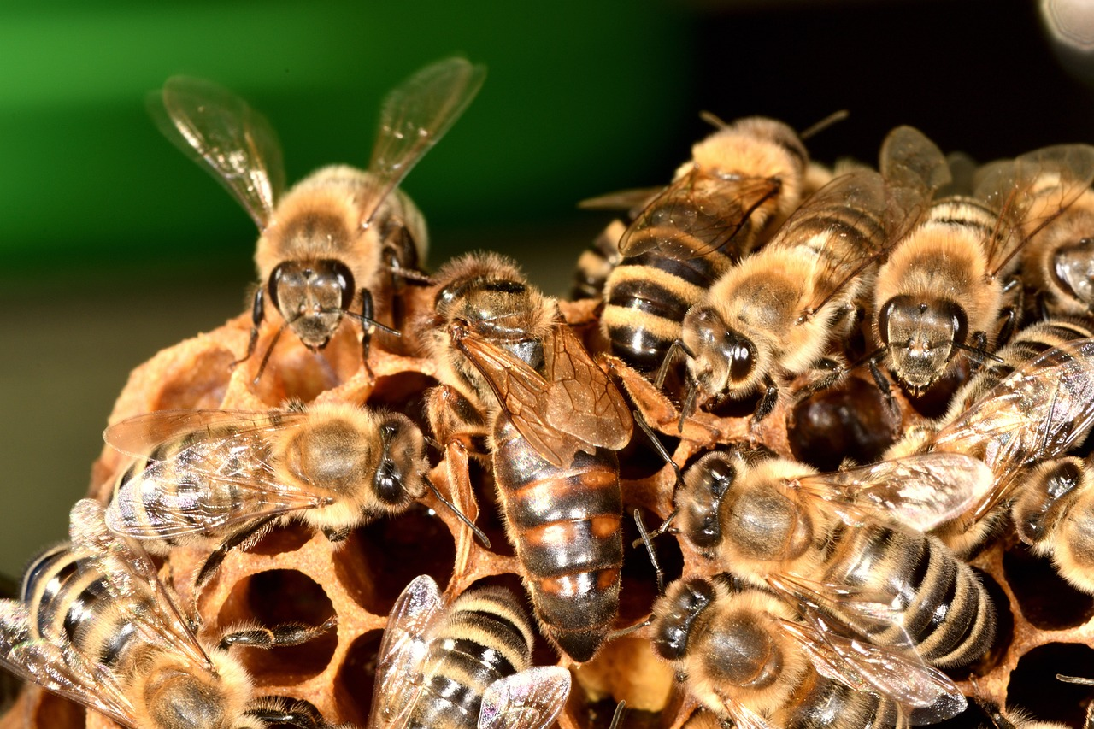
Their taunts and their teasing made her depressed…
She just wanted to be, like all the rest.

Slide 7
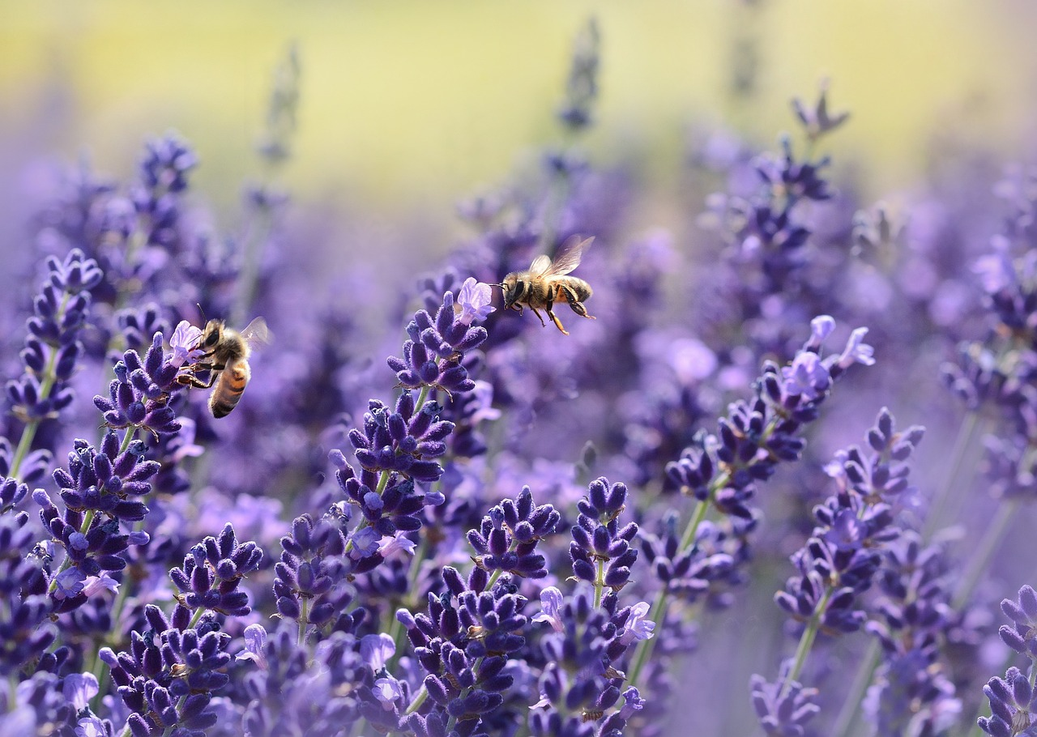
To collect nectar and pollen, her siblings would go…
but Collette stayed at home, because she was “too slow”.

Slide 8
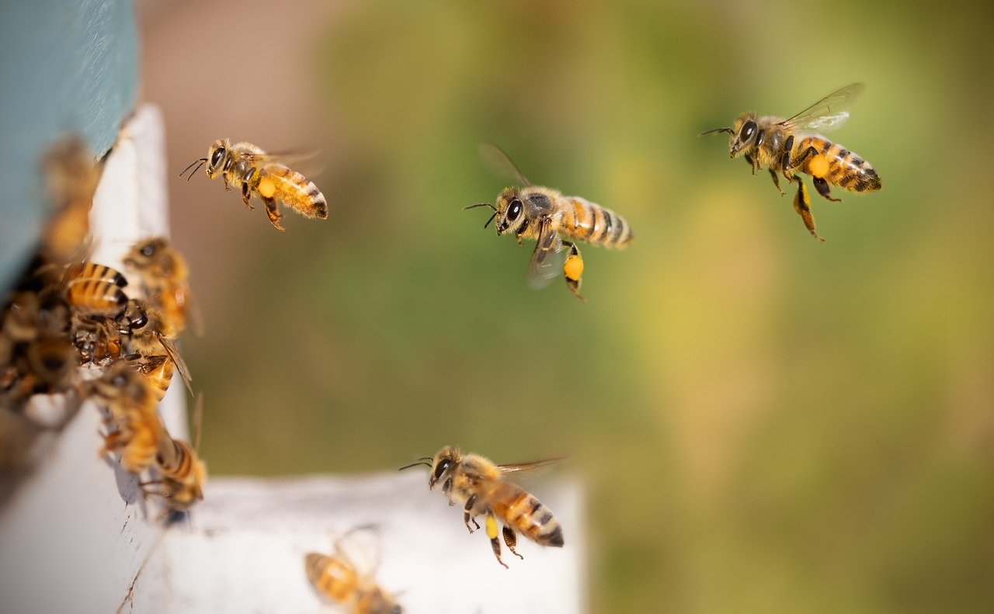
And when they came back, great stories they’d tell…
Of the bright colourful flowers and their wonderful smell.

Slide 9
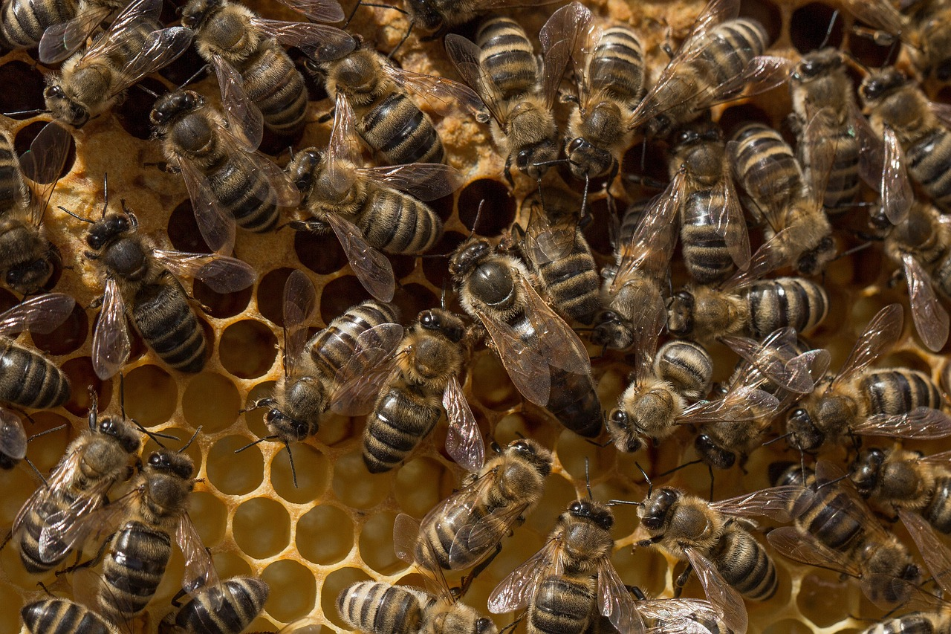
Collette longed to join them, and once even tried… But…
Come back Collette!
… the Queen bee had cried!

Slide 10
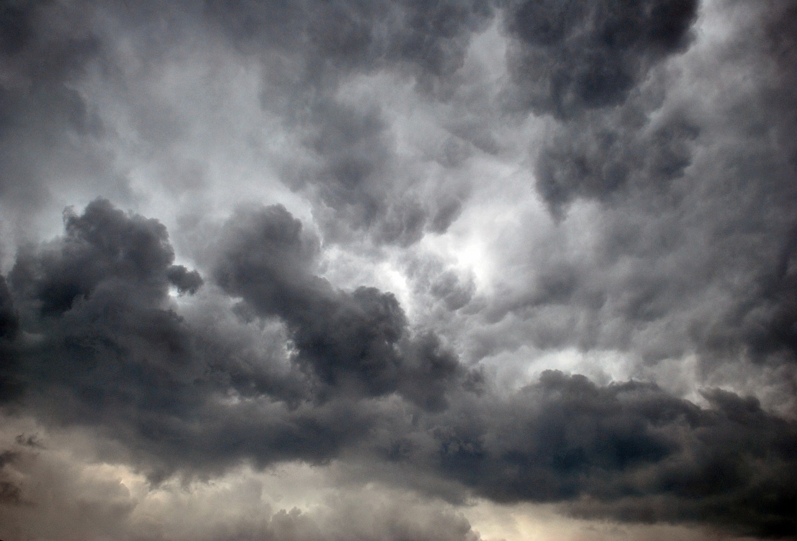
For weeks this went on, until one fateful day…
When the skies looked dark and the clouds had turned grey…

Slide 11
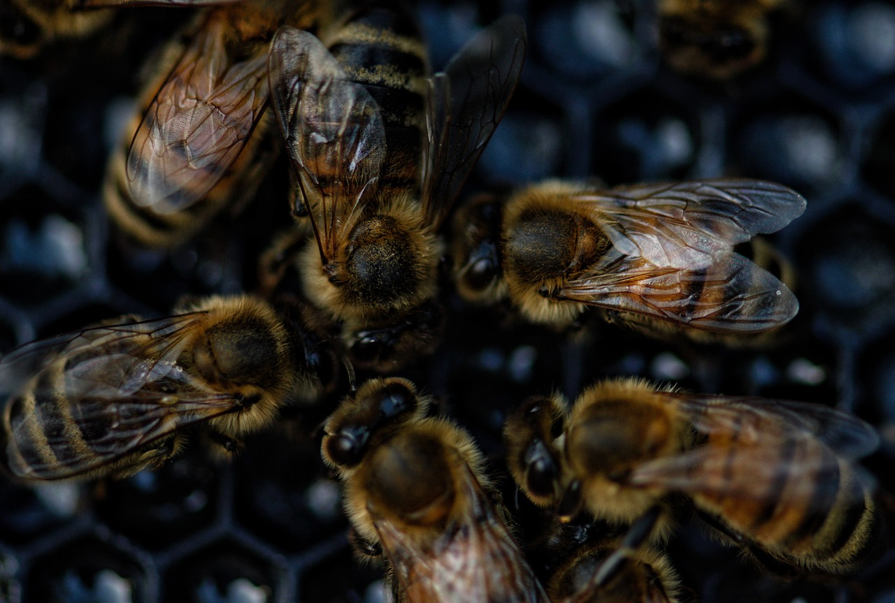
Her brothers and sisters were unable to fly…
They were all too poorly, to take to the sky.

Slide 12
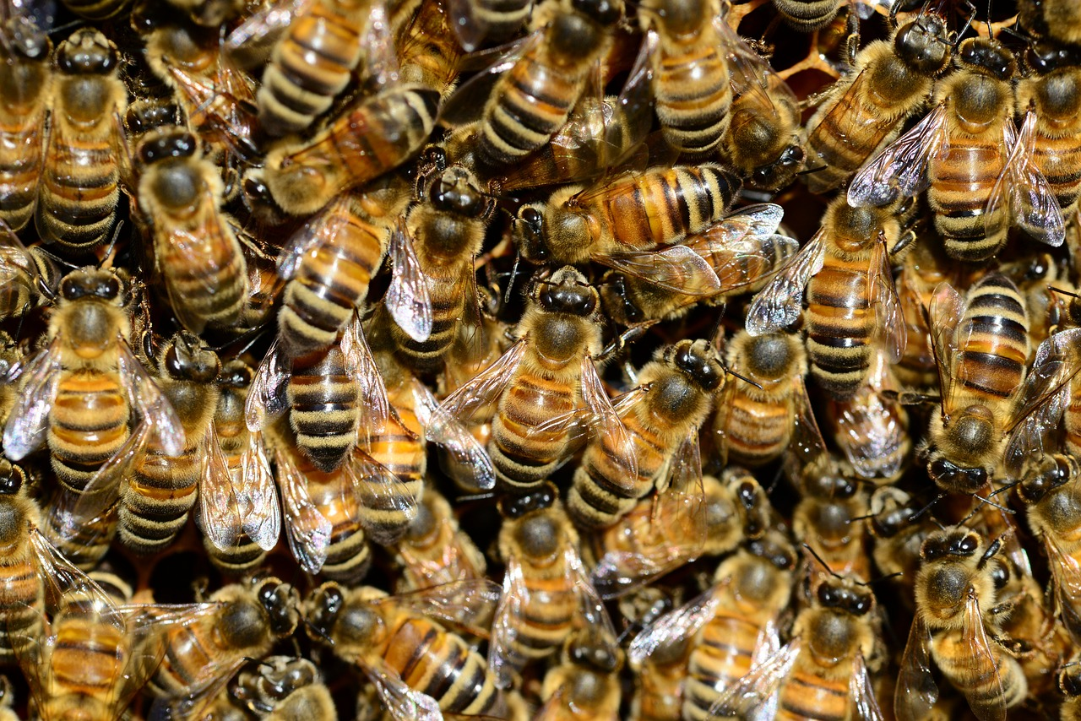
What had happened to them? Well, between me and you…
Cough!
Achoo!
Achoo!
Sneeze!
Sneeze!
Cough!
Sniff!
They’d all come down with a terrible flu.

Slide 13

The gardener who owned the field next door…
Had been spraying some chemicals all over the floor.

Slide 14
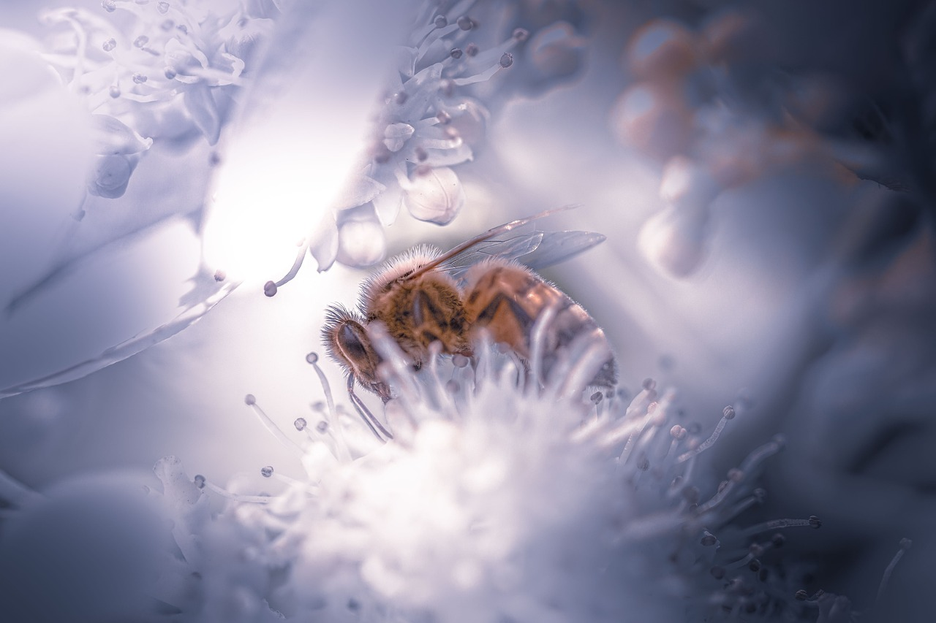
Some of this nasty, horrible stuff…
Had been drunk by the bees and it made them feel rough!

Slide 15
“What shall we do?!?”
…the Queen bee cried…”Without any pollen, how will we survive?!”

Slide 16
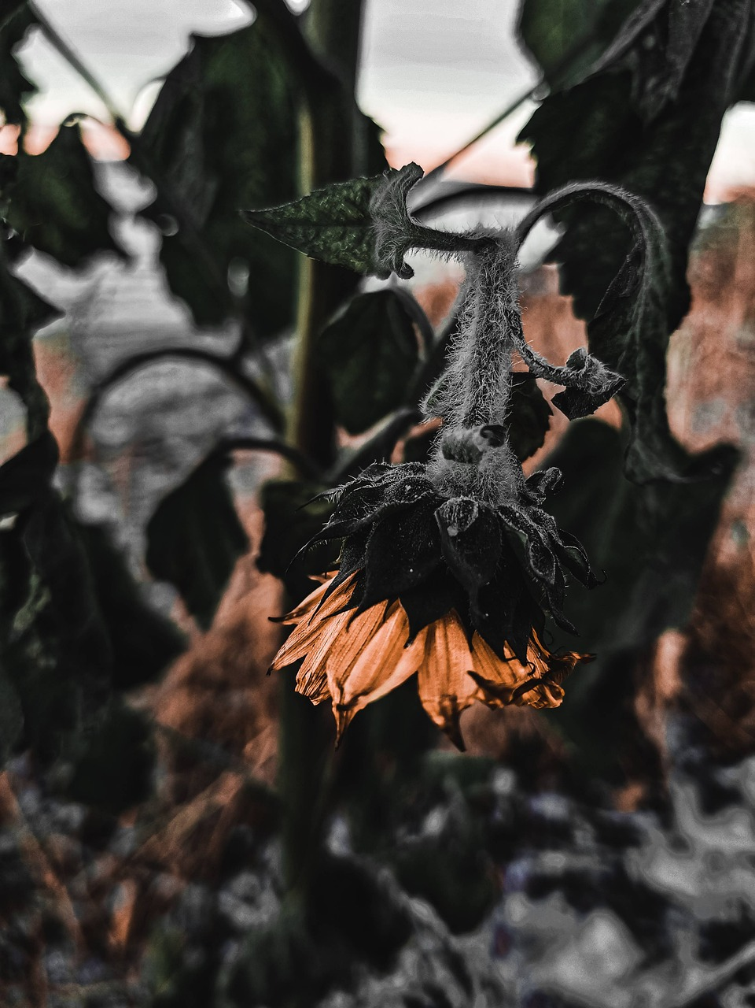
“The flowers won’t seed or the trees bear fruit”
…and that’s when she turned to her smallest recruit.

Slide 17
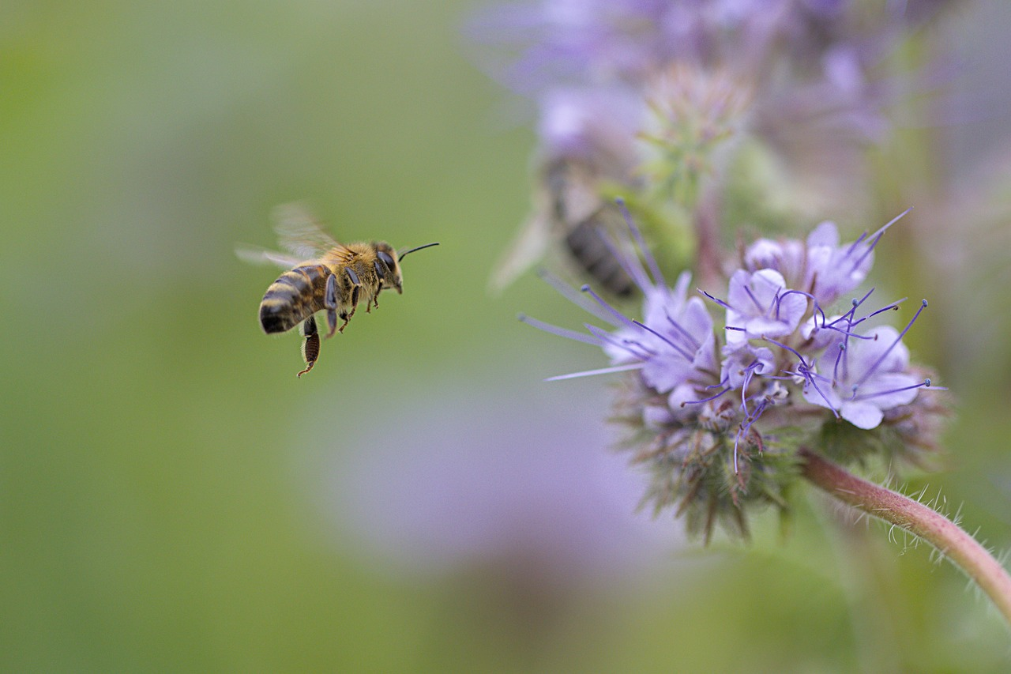
For the sake us all, she had a big job to do…
But without hesitation, away Collette flew.

Slide 18
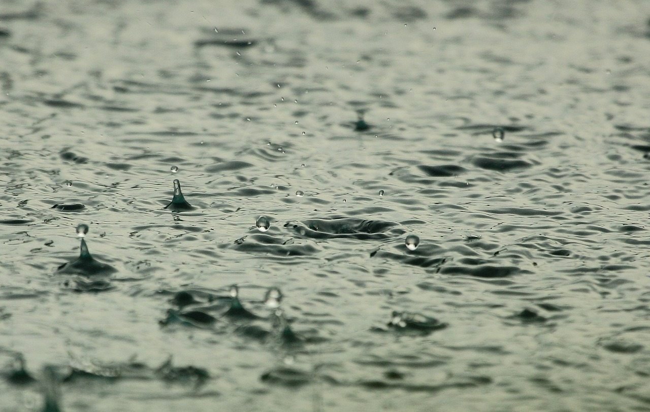
She darted and dodged the rain as it fell…
Determined to prove that she could do well.

Slide 19
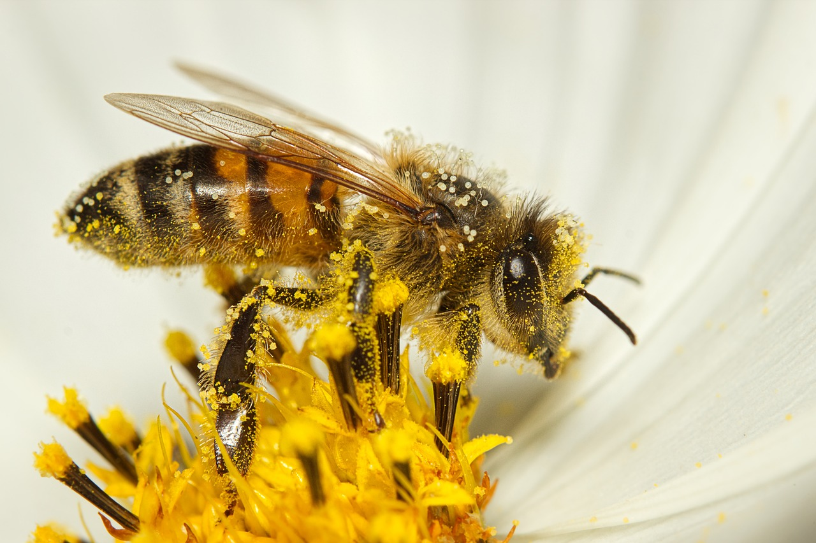
She stayed in the meadow for over an hour…
Moving the pollen from flower to flower.

Slide 20
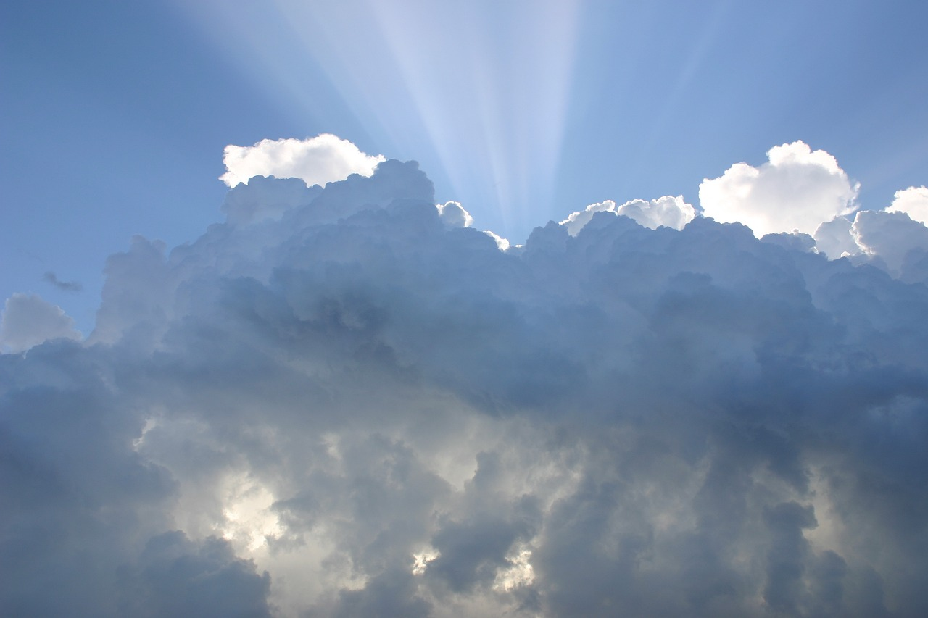
When the storm finally passed, out peered the Sun…
Collette trudged back to the hive, her job was done.

Slide 21
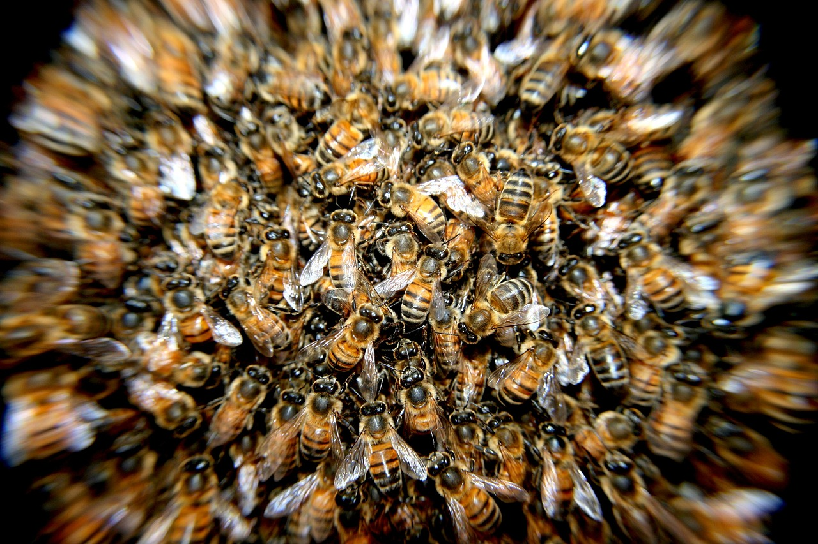
With tired little wings and aching knees…
You did it!
Hooray!
Well done!
Good job!
Go Collette!
Amazing!
Collette was embraced by the rest of the bees.

Slide 22
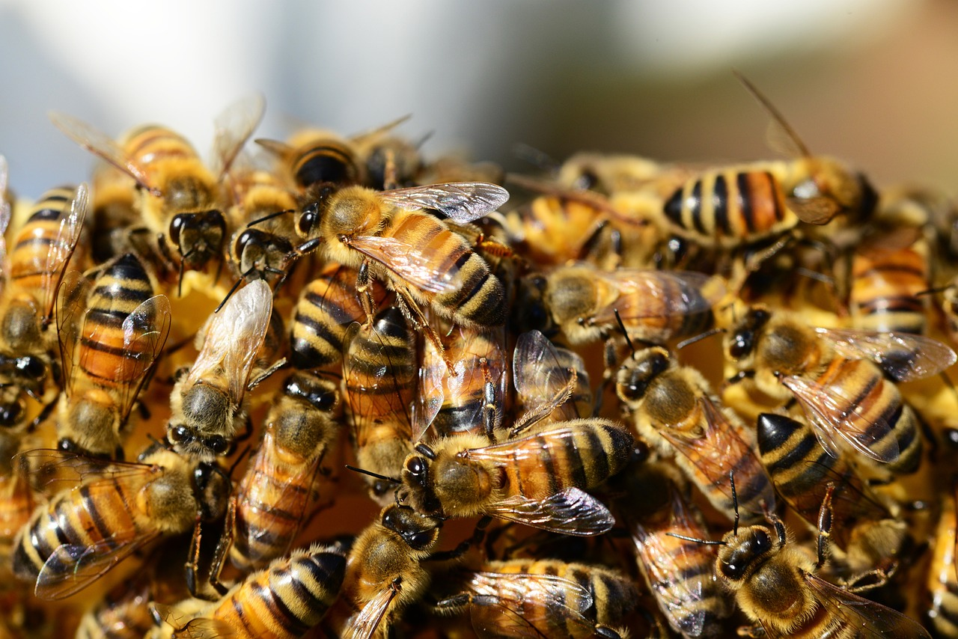
They patted her back and tussled her hair then hoisted her up, high into the air.

Slide 23
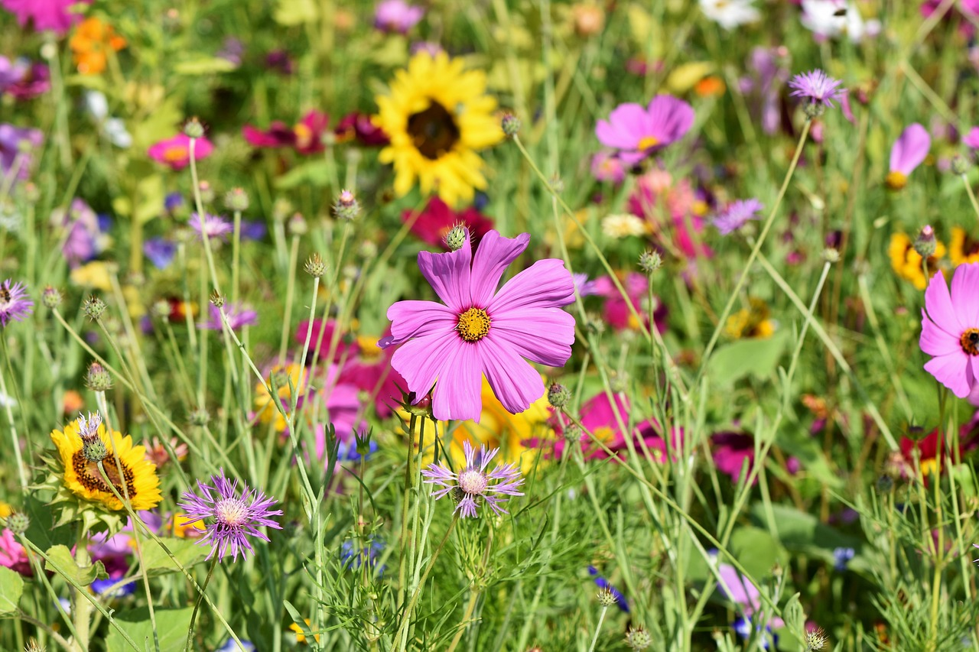
Collette had done it! An incredible deed!
The hive would have food and the flowers could seed!

Slide 24

And from this day on, everyone would know…
Although she was small and had struggled to grow…
Collect was mighty… and never “too slow”.

Slide 25
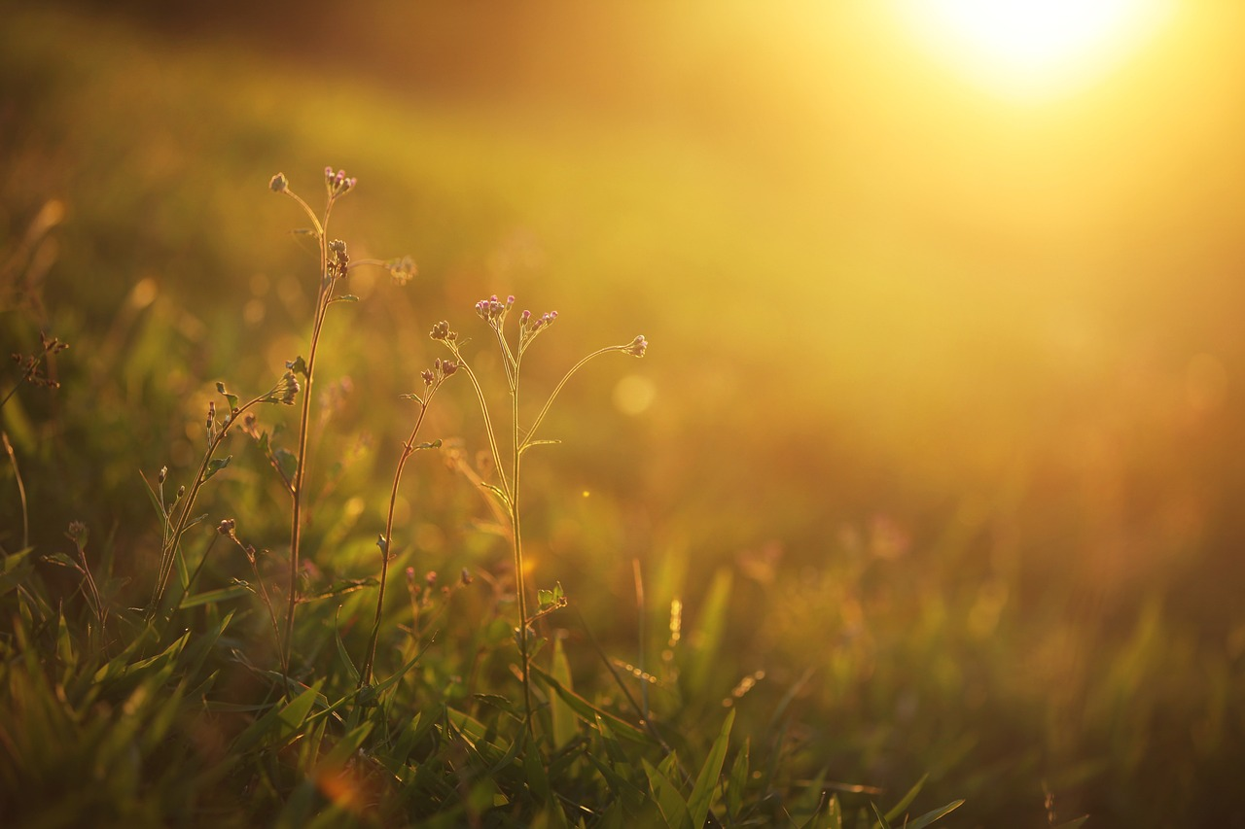
The End

Slide 26
Photo credits:
Slide 1: Image by Tiny-Hand from Pixabay
Slide 2: Image by Michaela, at home in Germany • Thank you very much for a like from Pixabay
Slide 3: Image by marian anbu juwan from Pixabay
Slide 4: Image by Melanie from Pixabay
Slide 5: Image by PollyDot from Pixabay
Slide 6: Image by xiSerge from Pixabay
Slide 7: Image by Rebekka D from Pixabay
Slide 8: Image by Ted Erski from Pixabay
Slide 9: Image by David Hablützel from Pixabay
Slide 10: Image by lwatteternal from Pixabay
Slide 11: Image by Terri Sharp from Pixabay
Slide 12: Image by PollyDot from Pixabay
Slide 13: Image by Nicholas_Demetriades from Pixabay
Slide 14: Image by Claude Mondestin from Pixabay
Slide 15: Image by David Hablützel from Pixabay
Slide 16: Image by Валерия Крячко from Pixabay
Slide 17: Image by DerWeg from Pixabay
Slide 18: Image by Roman Grac from Pixabay
Slide 19: Image by Michael Reichelt from Pixabay
Slide 20: Image by giografiche from Pixabay
Slide 21: Image by Patricio Sánchez from Pixabay
Slide 22: Image by PollyDot from Pixabay
Slide 23: Image by Ralph from Pixabay
Slide 24: Image by marian anbu juwan from Pixabay
Slide 25: Image by andalusian from Pixabay

