Slide 1

Climate Response
Your challenge today is to:
discuss how we, as individuals, can take positive action for the climate.
describe ways in which we can join together to demand that governments and organisations address the climate emergency.
edenproject.com/schools

Slide 2
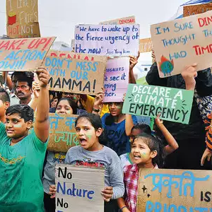
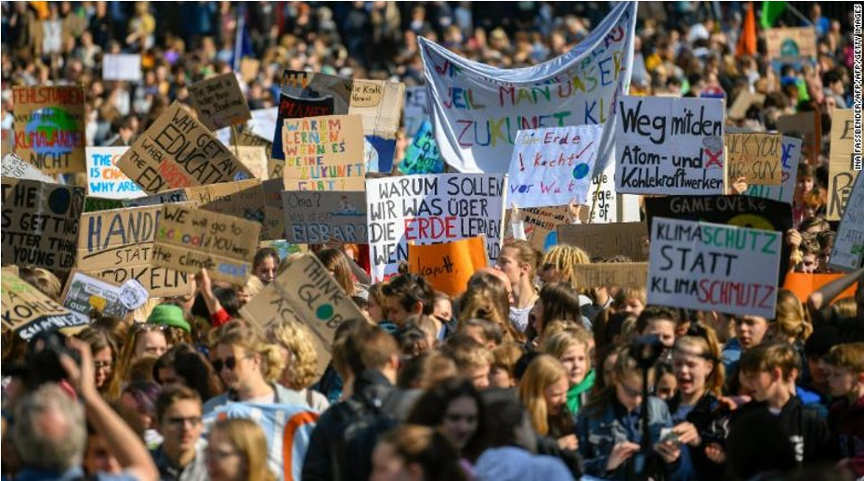
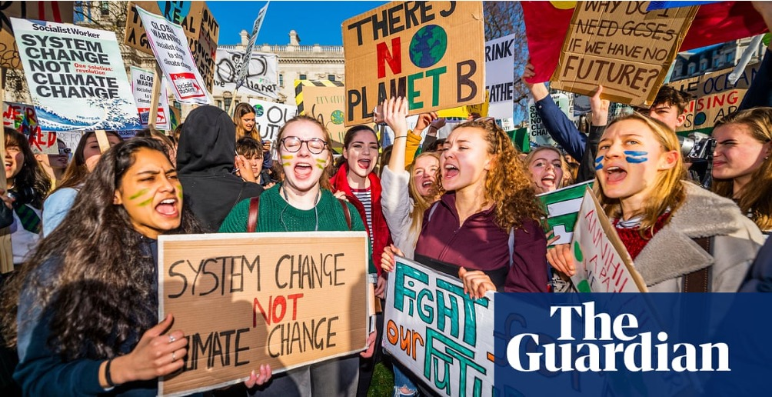
What are they photos of?
Where are they?
Who is involved?
Why are they doing it?
Notes:
https://www.theguardian.com/science/2019/mar/12/global-school-climate-strikes-share-your-videos-and-stories
https://edition.cnn.com/2019/05/24/world/global-climate-strike-school-students-protest-climate-change-intl/index.html
https://timesofindia.indiatimes.com/entertainment/events/hyderabad/city-students-join-global-climate-strike/articleshow/71234198.cms?from=mdr

Slide 3
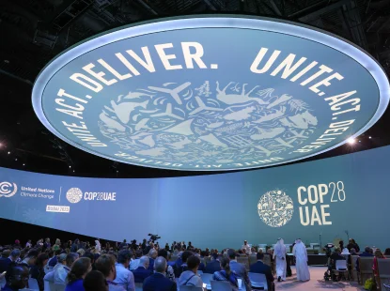
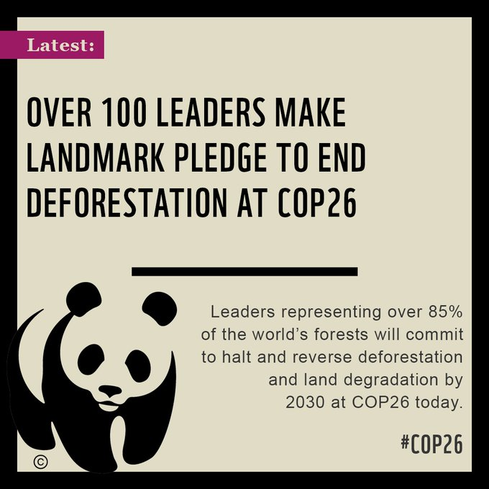

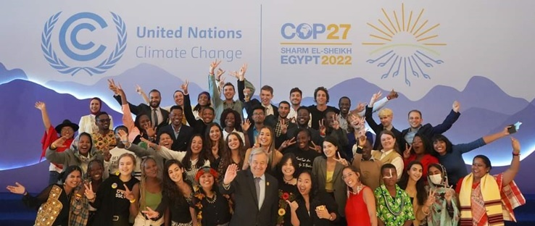
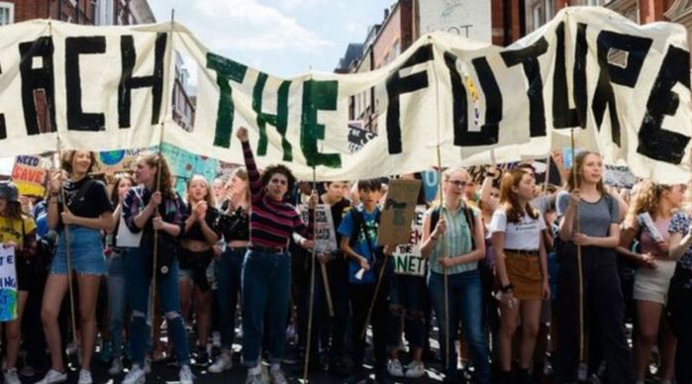


Notes:
https://www.cop28.com/en/
https://twitter.com/wwf/status/1455454418187571203?lang=bn
https://www.theccc.org.uk/2020/06/25/covid-19-can-be-an-historic-turning-point-in-tackling-the-global-climate-crisis/
https://www.coy18uae.org/
https://www.gwp.org/en/GWP-Caribbean/WE-ACT/news-page/News-and-Activities/cop-27-and-coy-17-experience-of-young-professional-adelin-pierre-from-haiti/
https://www.teachthefuture.uk/
https://www.teachingtimes.com/teach-the-future/

Slide 4

Why is the
climate changing?

Slide 5
Things that put Carbon dioxide and other greenhouse gases into the atmosphere…
Notes:
www.edenproject.com

Slide 6

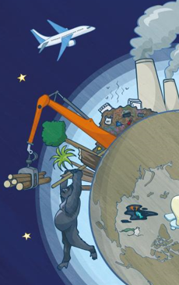
1
Livestock produce methane
Making electricity in fossil fuel power stations
Transport – planes, car, ships and lorries
Making stuff in factories
Deforestation
Landfill produces methane
3
2
2
4
1
3
6
4
5
5
6
Notes:
www.edenproject.com

Slide 7
This NASA animation shows the changes in global temperatures since 1880. Higher than normal temperatures are shown in red and lower than normal temperatures are shown in blue. What do you notice?
Notes:
https://svs.gsfc.nasa.gov/4882

Slide 8
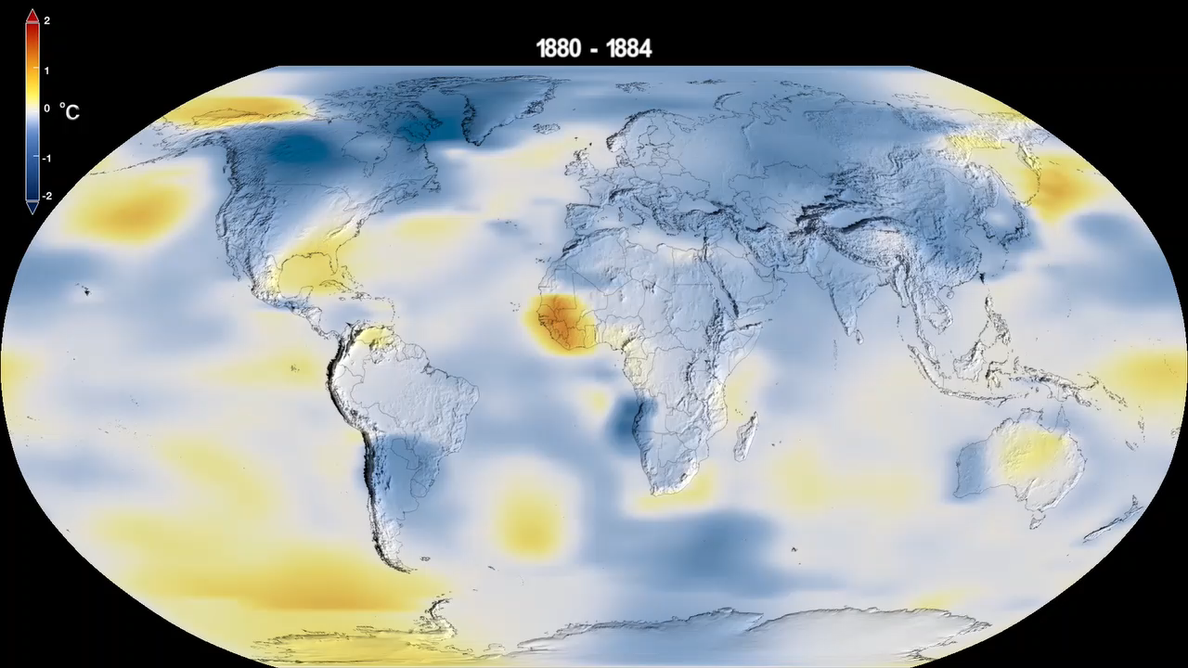
Notes:
https://svs.gsfc.nasa.gov/4882

Slide 9
Being part of the solution
Doers
Shoppers
Learners
Shouters

Slide 10
Doers
Hands on stuff

Slide 11

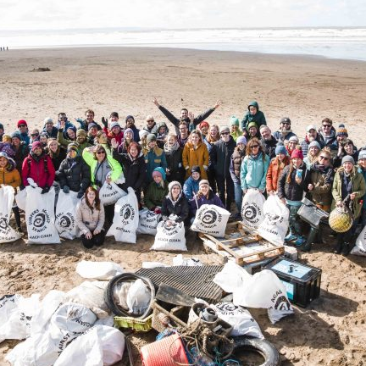


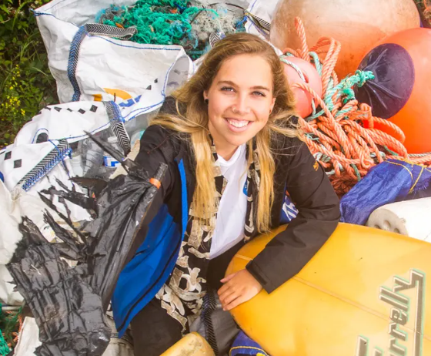
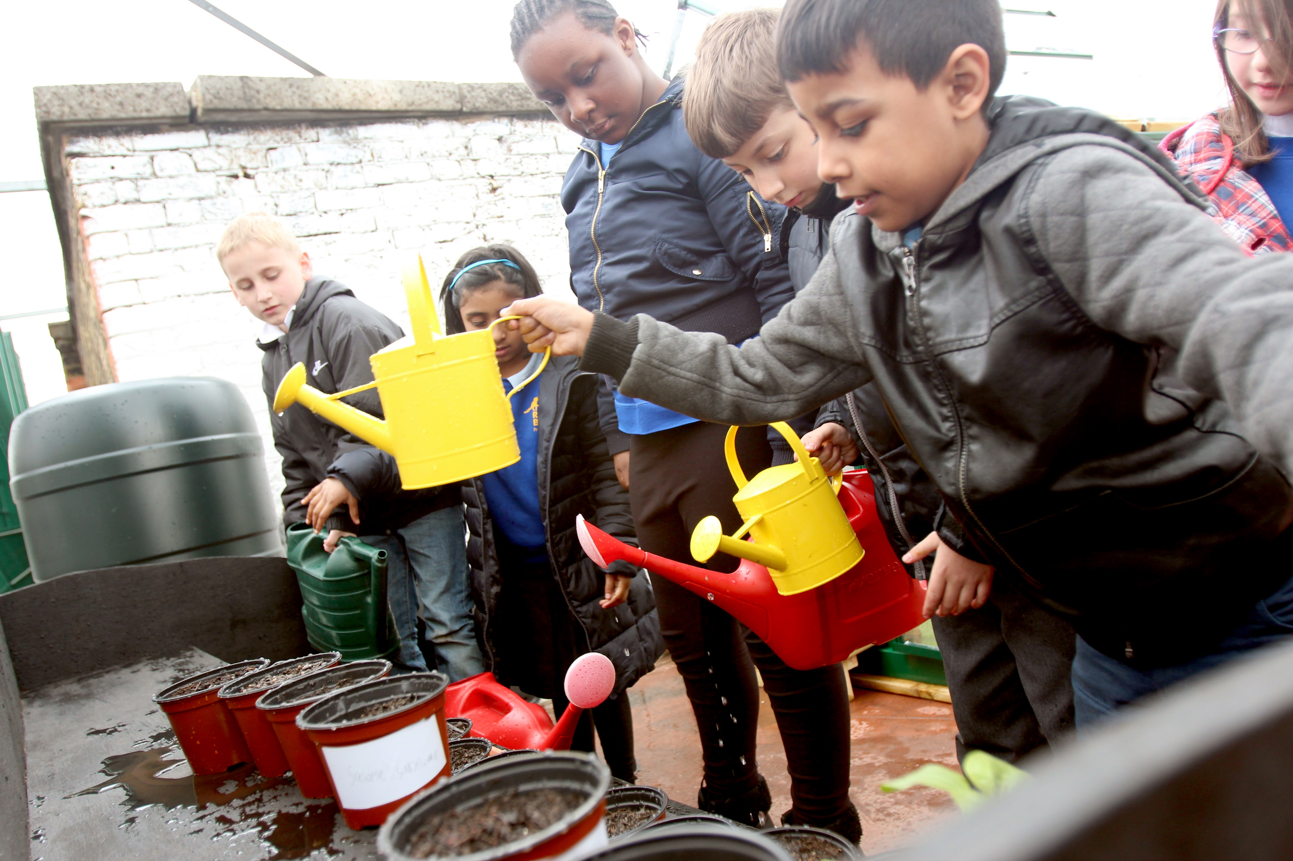
27 March, 2022
climatevisuals.org Credit: 10:10 /
Notes:
https://www.theguardian.com/environment/2022/mar/27/pick-up-the-pieces-cornwalls-beach-cleaners-tackling-plastic-pollution
https://www.sas.org.uk/news/45700-volunteers-join-the-biggest-ever-uk-beach-clean/

Slide 12
climatevisuals.org Credit: 10:10
Notes:
https://climatevisuals.org/search/?searchQuery=gardening (1067)

Slide 13
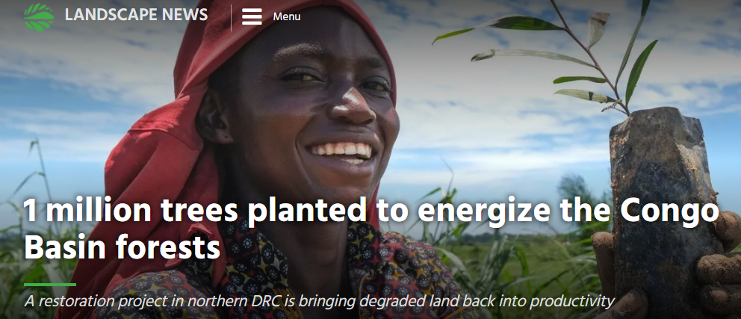
April, 2021
Notes:
https://news.globallandscapesforum.org/51923/1-million-trees-planted-to-energize-the-congo-basin-forests/

Slide 14

Shoppers
Choices when you buy stuff

Slide 15

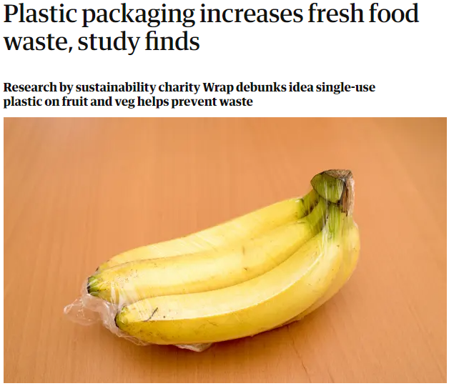
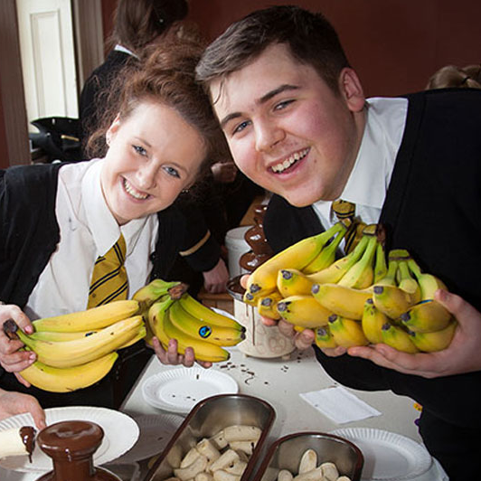
24 February, 2022
Notes:
https://www.theguardian.com/environment/2022/feb/24/plastic-packaging-increases-fresh-food-waste-study-finds

Slide 16



Notes:
https://www.rainforest-alliance.org/faqs/what-does-rainforest-alliance-certified-mean
https://schools.fairtrade.org.uk/fairtrade-schools-awards/
https://octopus.energy/

Slide 17

Learners
Seeking knowledge
and staying informed

Slide 18
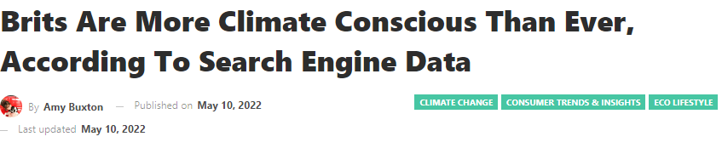

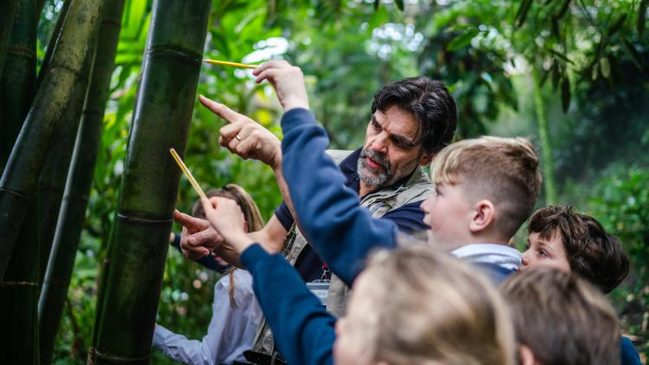
Over 40,000 school children visit Eden Project each year!
Notes:
https://www.greenqueen.com.hk/uk-climate-conscious-search-data/

Slide 19
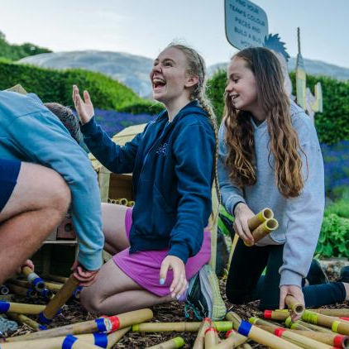
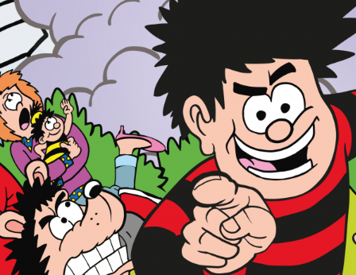

Join us for an action-packed summer programme and help Dennis and friends save Eden from the dreaded CO₂-zilla!
Notes:
https://www.edenproject.com/learn/schools
https://www.edenproject.com/visit/whats-on/go-wild-with-beano-at-eden

Slide 20

Shouters
Sharing what you care about

Slide 21
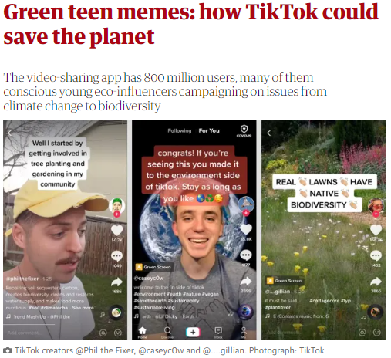
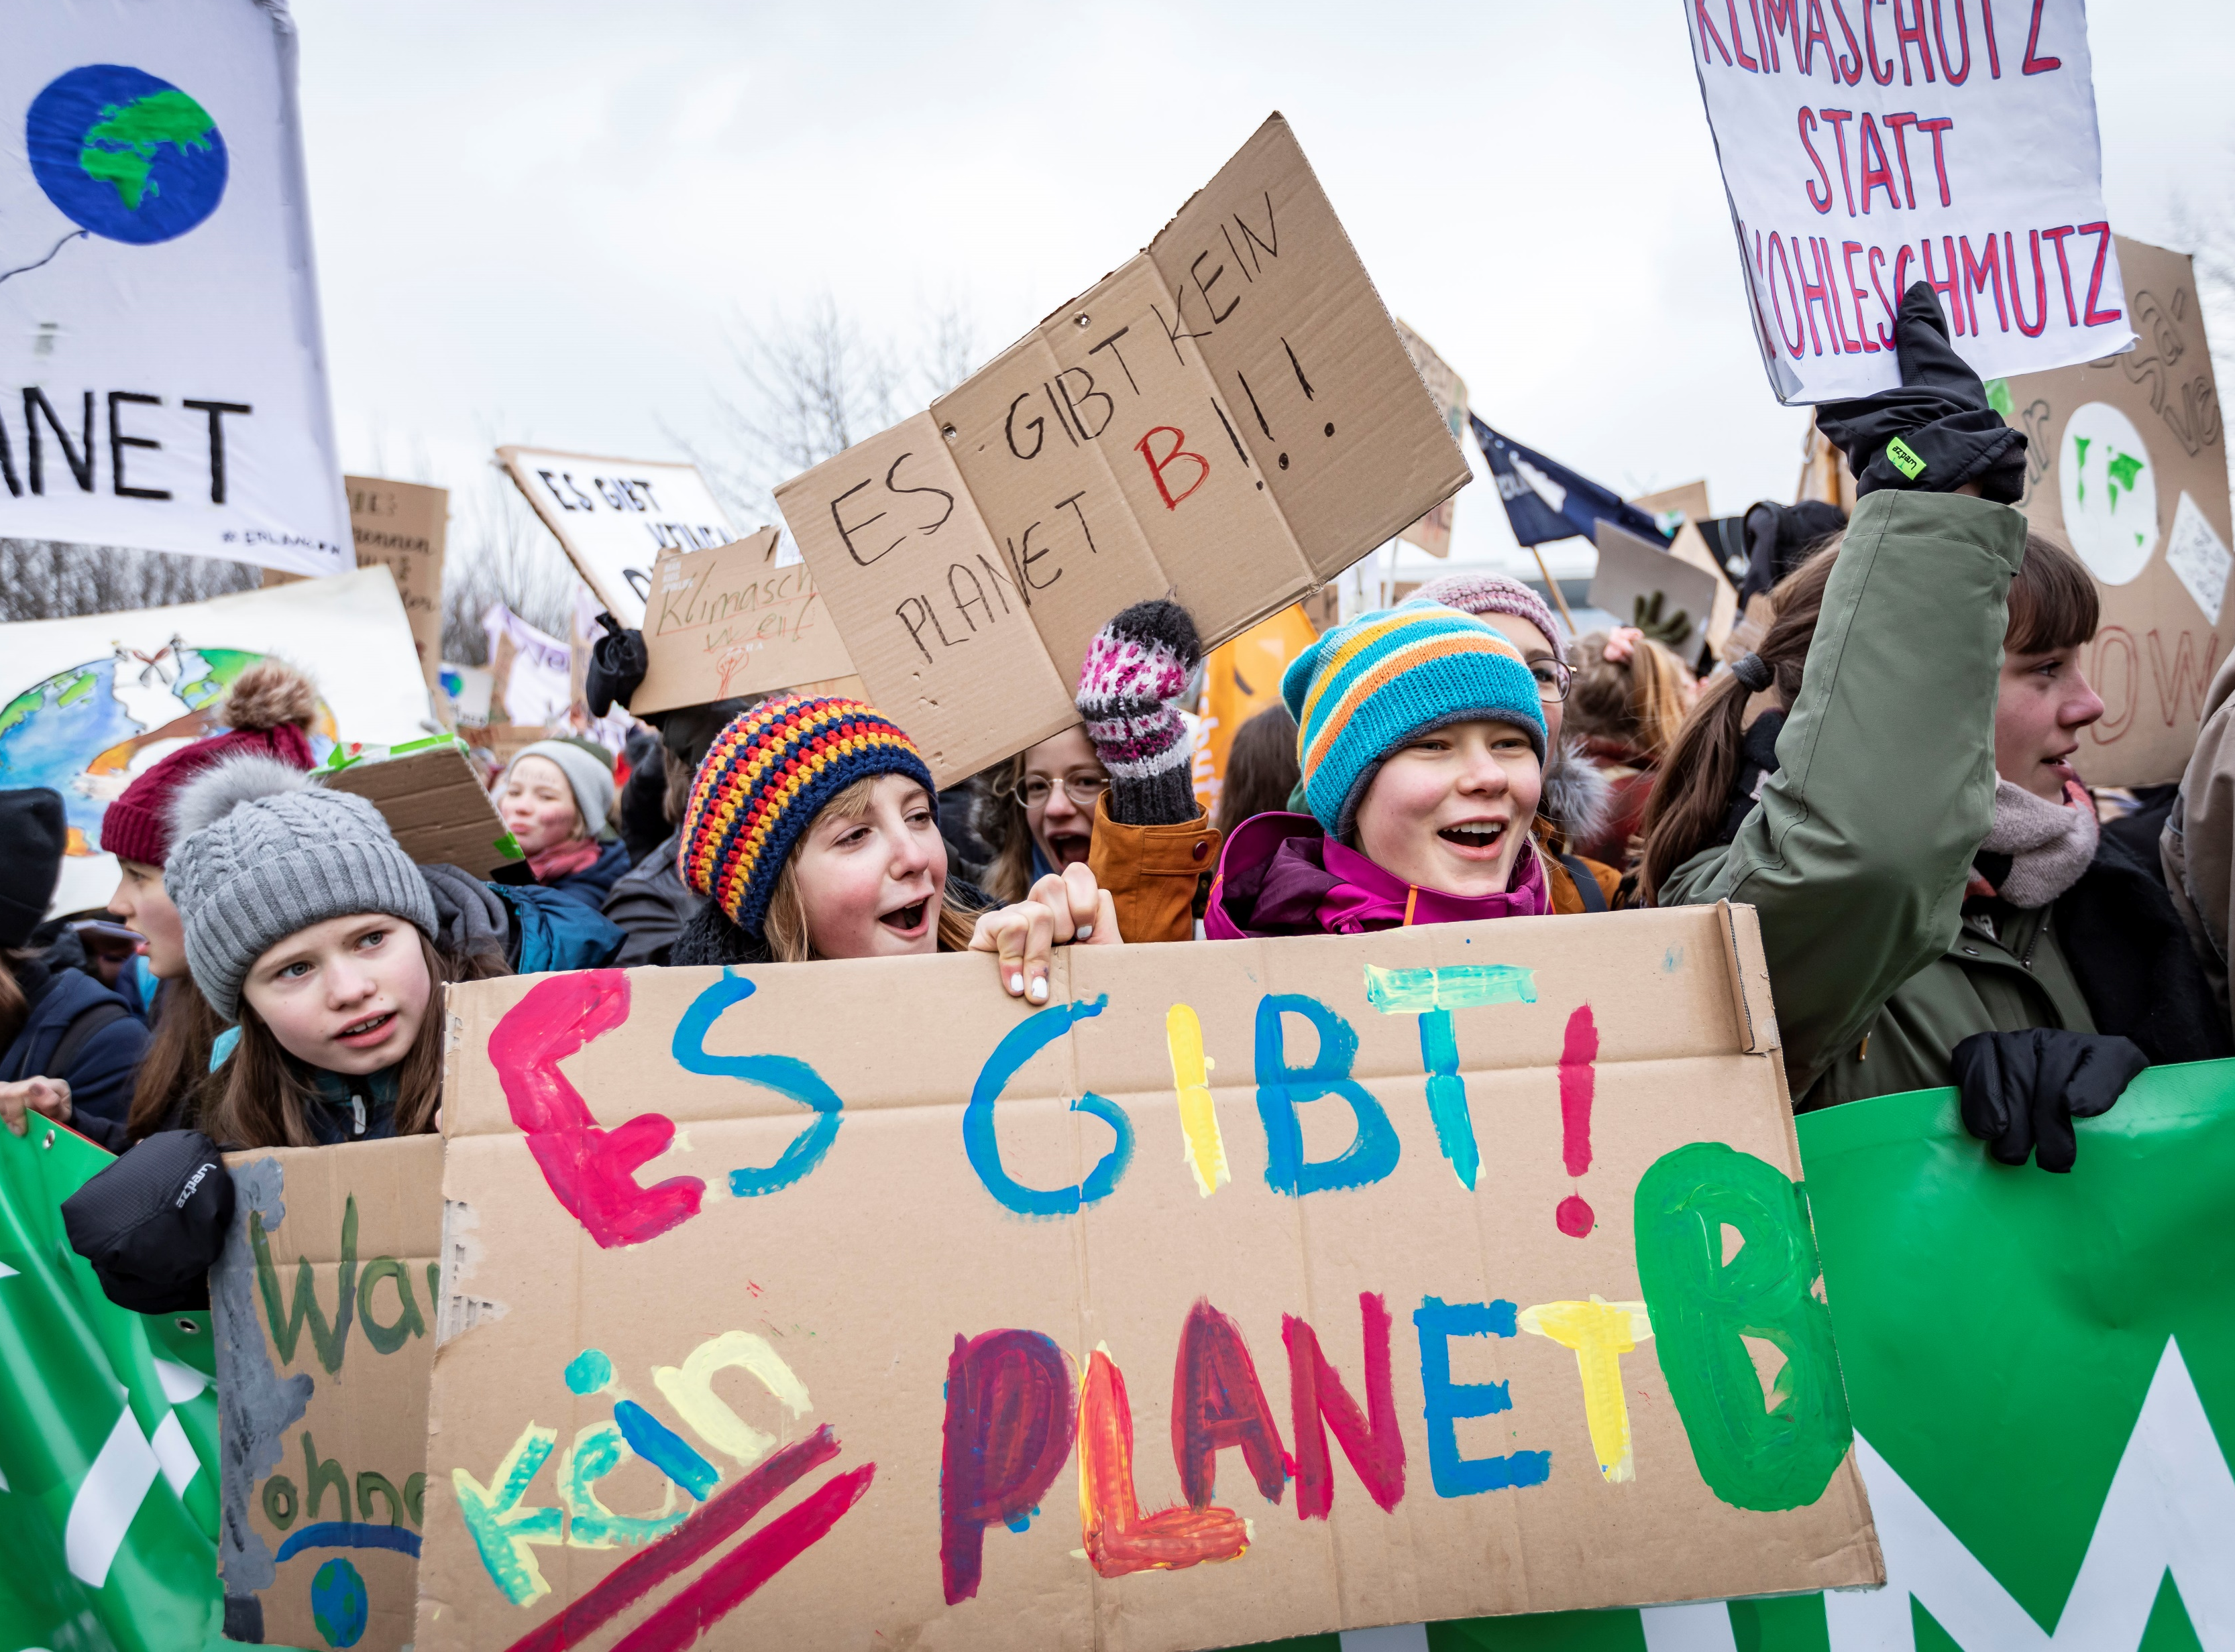
Climatevisuals.org Credit: Jörg Farys / Fridays for Future
Notes:
https://www.theguardian.com/environment/2020/aug/28/green-teen-memes-how-tiktok-could-save-the-planet-aoe
https://climatevisuals.org/search/?searchQuery=1171

Slide 22
What sort of person do you think you are (mainly)?
Shoppers
Choices when you buy stuff
Shouters
Sharing what you care about
Doers
Hands on stuff
Learners Seeking knowledge

Slide 23
Finally: Can an individual really have an impact?
If I eat less meat, buy local food, ride my bike, buy less “stuff”, recycle more, waste less food, talk to people about the planet…
…does it really make any difference?
Notes:
https://svs.gsfc.nasa.gov/4882

Slide 24
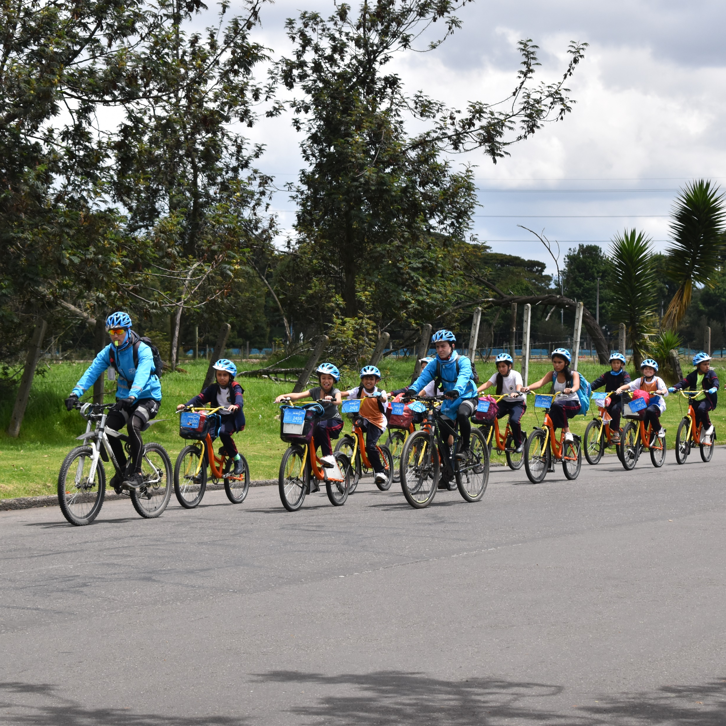
Finally: Can an individual really have an impact?
YES! Your actions matter.
Your own actions will reduce your personal carbon dioxide emissions.
We influence each other – when one person makes a decision to help the environment, other people notice and join in.
climatevisual.org Credit: Ashden/Ashden

Slide 25

Notes:
letsgozero.org

Slide 26
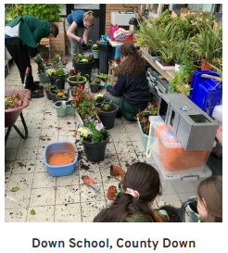
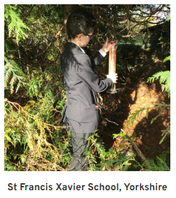
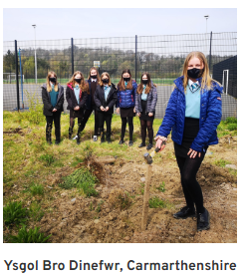

Notes:
letsgozero.org

Slide 27
Climate Response
Your challenge today is to:
Discuss ways in which individuals can respond
confidently to the climate emergency.
Describe how we can join together to demand that governments and organisations act to address the climate emergency.
edenproject.com/schools

Slide 28

Climate Response
Eden Project would be keen to know about ways in which you decide to take action.
Please share via X
@EdenProject #makethechange
youtube.com/watch?v=fW8amMCVAJQ

