Slide 1

Our Sustainable School:
An Introduction to Sustainability

Slide 2
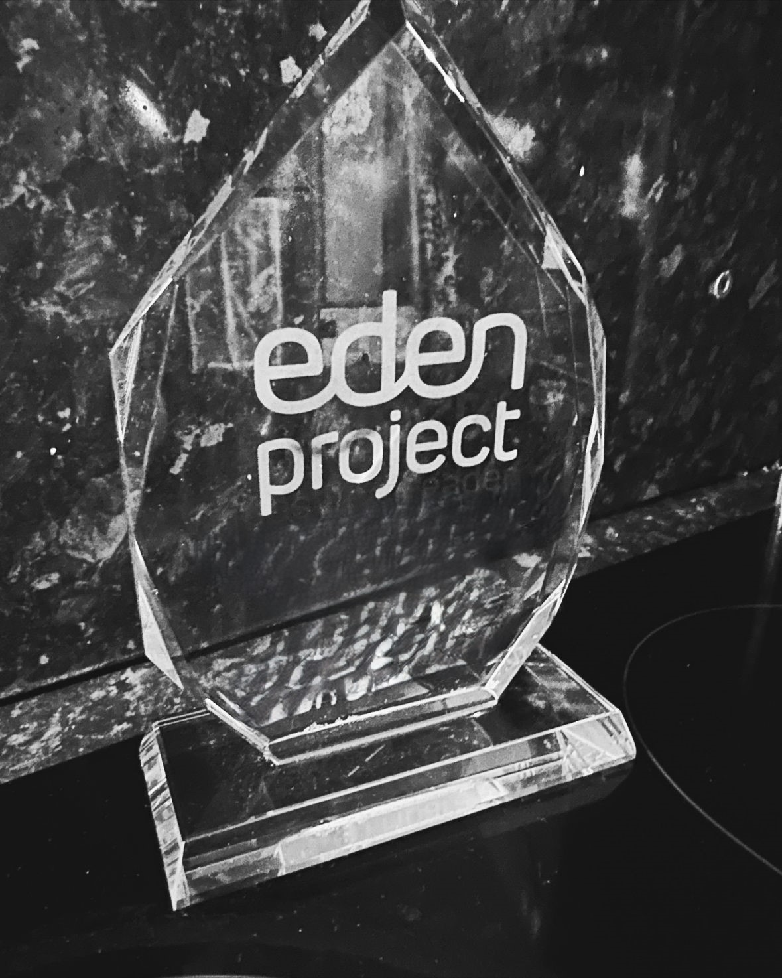
Imagine…
10 years from now, your school has been nominated for the prestigious ‘Eden Project Award’ for being the most ‘People and Planet Friendly School’ in the country.
Your challenge today, is to develop a vision for this people and planet friendly school, prioritising what action needs to be taken now to make it a reality.

Slide 3
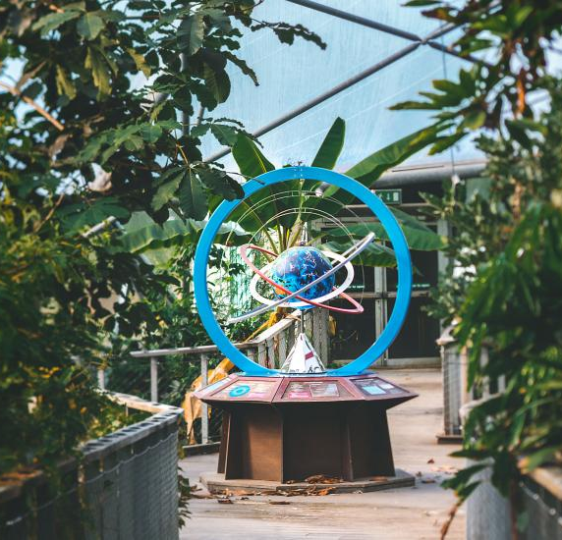
What would ‘the most people and planet friendly school’ be like?
Where do lessons take place?
What does the outdoor space look like?
Which subjects are taught?
What kind of food is served at lunchtimes?
How do people travel to and from school?
How is everybody given the best opportunities to learn?
What role do pupils have in this place?
What actions do people take to save water and energy?
What do people do with their rubbish?
What else is special about the school?

Slide 4
Turning your ideas into a set of statements
Let’s use the sentence starter: ‘The school that wins the Eden Project Award would…’

Slide 5
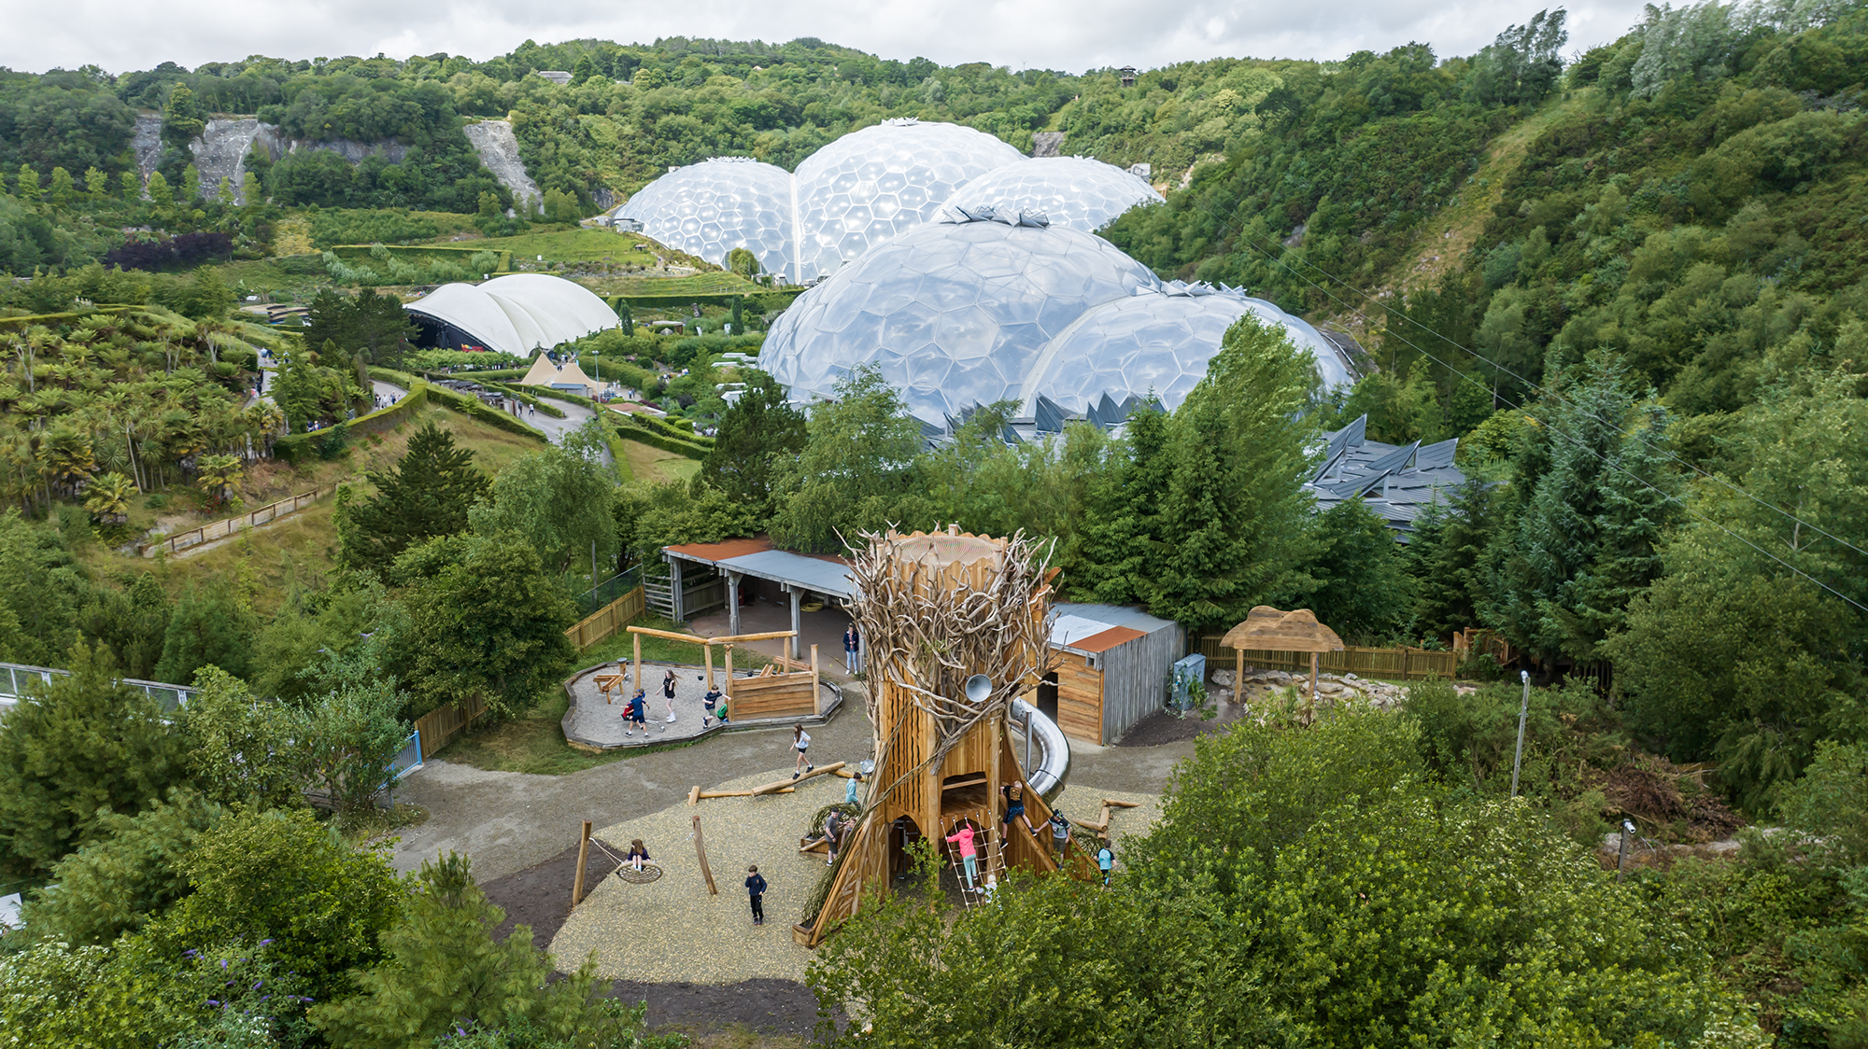
Organisations around the world have been doing similar thinking to you!
They have been thinking about how they can run their organisations in a way that is prosperous for them and leads to a better future for the planet and the people who live on it.
This is called ‘sustainable thinking’.
The Eden Project does a lot of this!

Slide 6
‘Sustainable’
Have you heard of this word before?
Where have you heard it?
What do you think it means?

Slide 7
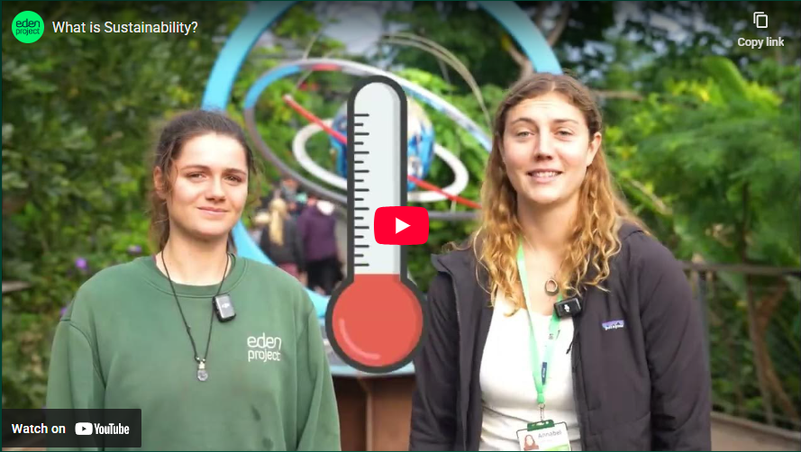
Explaining Sustainability

Slide 8


Sustainability – ‘meeting the needs of the present without compromising the ability of future generations to meet their own needs’.
Brundtland Report 1987

Slide 9
What are the three key considerations (or ‘circles’ in the video) for sustainability?
Social
Environmental
Economic

Slide 10





The Eden Project often uses a tool called ‘The Development Compass Rose’.
Nature.
Is it good for the environment?
North
Economic.
Is it affordable?
Who decides?
West
East
Social.
Is it good for other people?
South

Slide 11
Using the Development Compass Rose Activity
Should the Eden Project Café sell spring water?
Read through the statements one at a time.
After reading each one, decide where it should be placed on the Development Compass Rose (depending on which aspect of sustainability it relates to).
Sort all statements under the correct headings.
Having sorted your statements, consider the positives and negatives of selling spring water at Eden Project.
Decide on your answer to the question. Be prepared to explain your answer.

Slide 12
Who decides?
There is not necessarily always a clearly ‘right’ or ‘wrong’ answer.
It is important to remember that the decisions we make have a wider impact than we may have previously realised.
We need to be ‘critical thinkers’ and use the information that we have available to make the best choices that we can at the time.

Slide 13
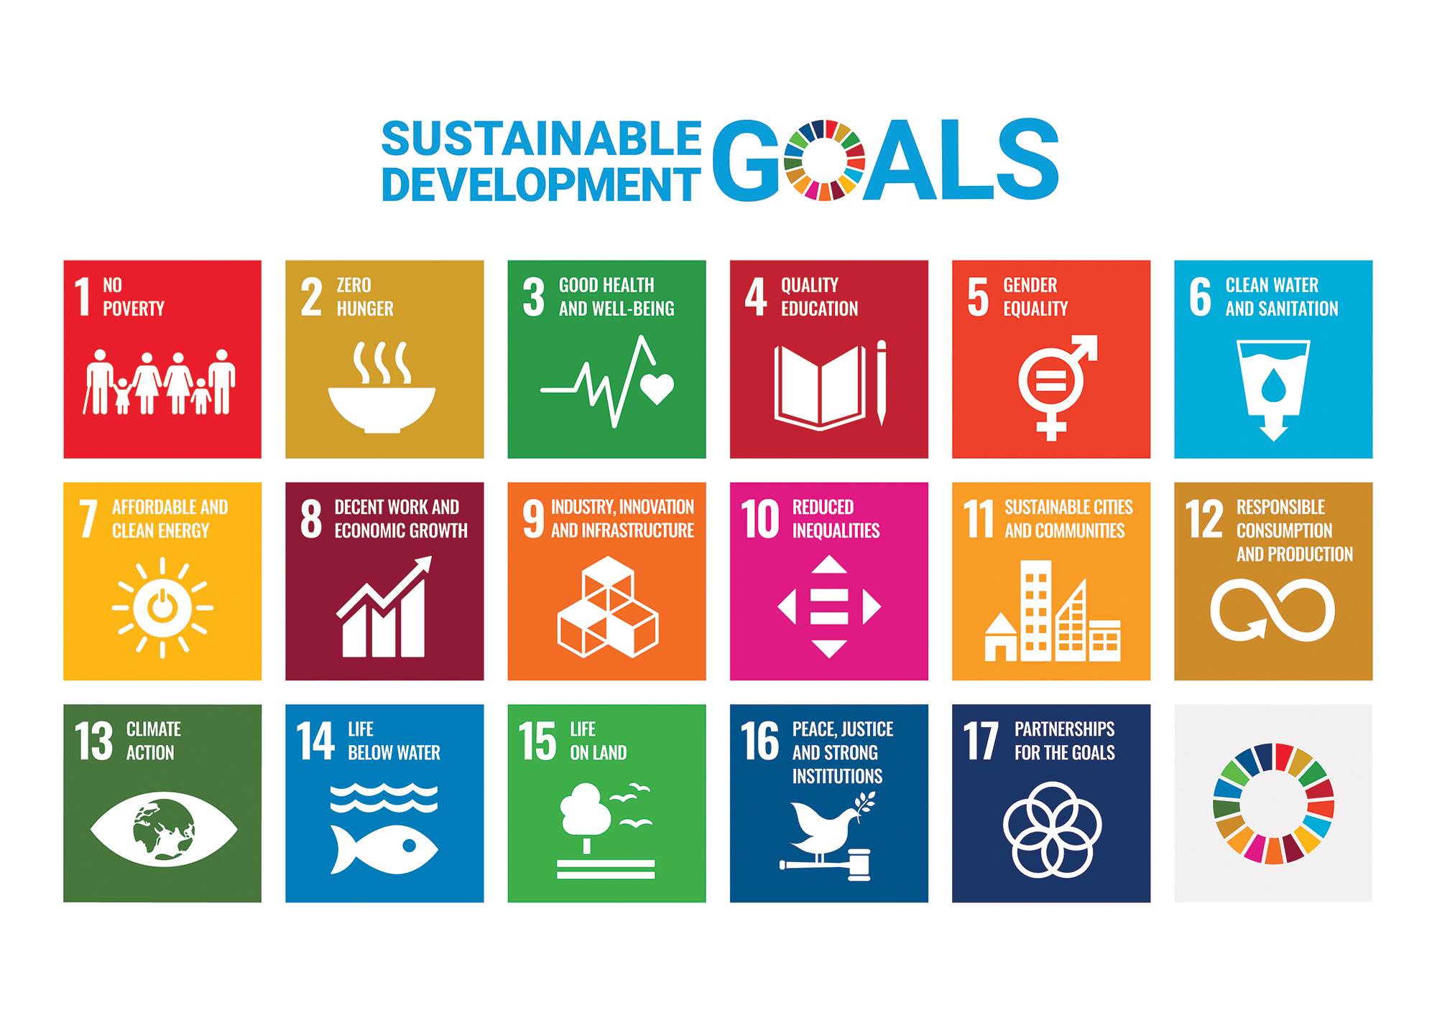
The United Nations has also been putting a lot of thought into sustainability.
They have created the Sustainable Development Goals, with the aim of ensuring "peace and prosperity for people and the planet, now and into the future”.
Notes:
Something that is truly sustainable will be good for all three (nature, economy and people).

Slide 14
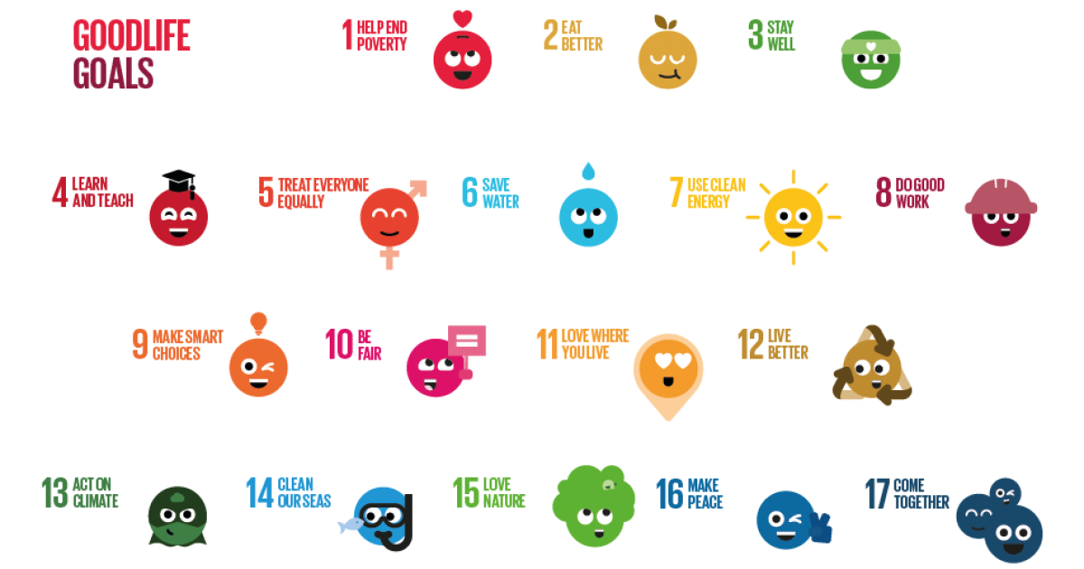
Notes:
Something that is truly sustainable will be good for all three (nature, economy and people).

Slide 15



Look at the three examples below, where would you put them on the Development Compass Rose?
Nature.
Who decides?
Economic.
Social

Slide 16
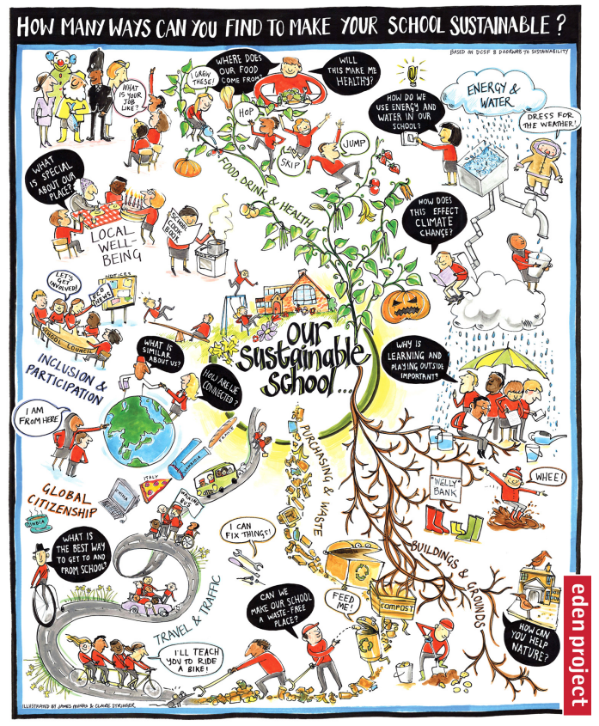

Back to our school

Slide 17
Task
Think about your school at the moment, are any of these things already happening?
Pick one thing that you think could be improved within your school, in terms of sustainability.
Write a paragraph explaining what currently happens in this area and offer suggestions about how to improve it. You should refer back to the Development Compass Rose in your work.
The sentence starters below could help you structure your work:
I think that in our school we should consider doing………. to make it more sustainable.
I can see that currently we aren’t doing very well at this because……..
If we put this plan into action is would have the following impacts on nature/ the economy/ socially….
Therefore, on balance, I think it would be a sensible way to focus our efforts and help the school on its sustainability journey.

Slide 18
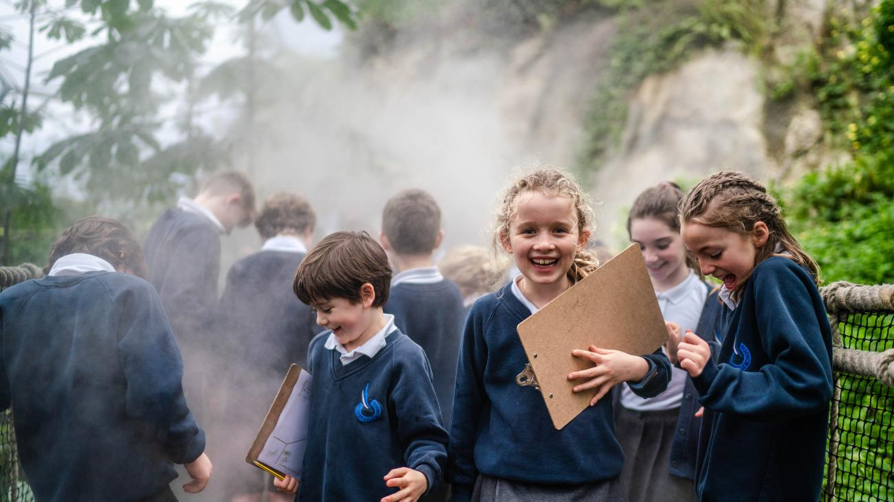
Conclusion
By creating your vision for your school and thinking about the actions they could take here and now, you have taken the first step towards becoming the most ‘People and Planet Friendly School’ in the country.

