Slide 1

Sustainable Eden Sessions
A Lesson Plan For Teachers

Slide 2
What are the three key aspects of sustainability?
Social
Economic
Environmental

Slide 3
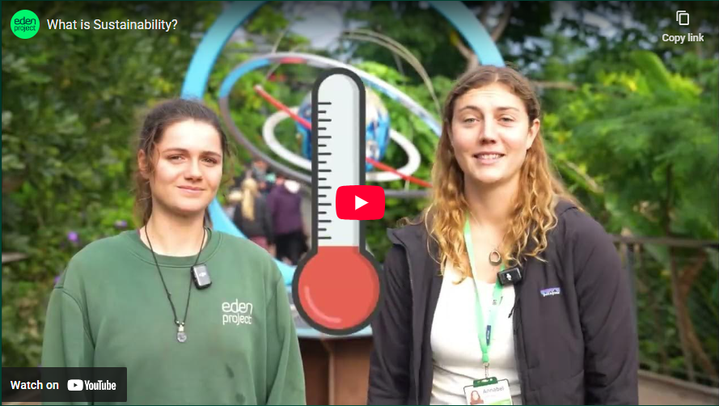
Explaining Sustainability

Slide 4


Sustainability – ‘meeting the needs of the present without compromising the ability of future generations to meet their own needs.’ Brundtland Report 1987

Slide 5
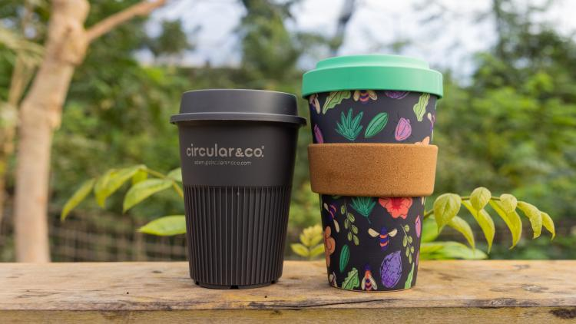
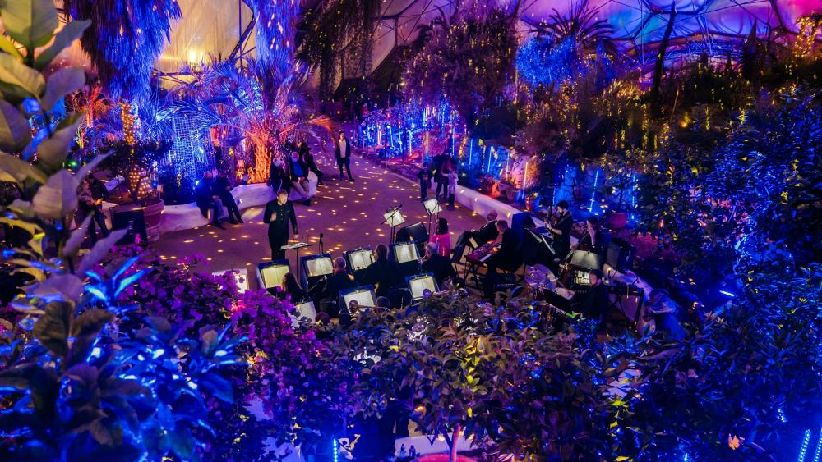
The Eden Project consider all aspects of sustainability when thinking about everything that they do- from big events to the coffee they sell in their cafes.

Slide 6

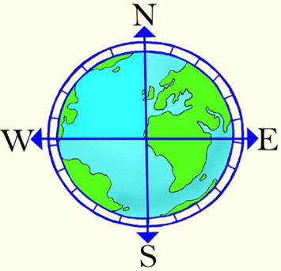



At the Eden Project they often use a tool called ‘The Development Compass Rose’.
Nature.
Is it good for the environment?
North
Economic.
Is it affordable?
Who decides?
West
East
Social.
Is it good for other people?
South

Slide 7

Using the Development Compass Rose Activity
How sustainable is it to put on large music events?
Read through the statements one at a time.
After reading each one, decide where it should be placed on the Development Compass Rose (depending on which aspect of sustainability it relates to).
Sort all statements under the correct headings.
Having sorted your statements, consider the positives and negatives of selling water at Eden.
Decide on your answer to the question. Be prepared to explain your answer.

Slide 8
Who decides?
There is not necessarily always a clearly ‘right’ or ‘wrong’ answer.
It is important to remember that the decisions we make have a wider impact than we may have previously realised.
We need to be ‘critical thinkers’ and use the information that we have available to make the best choices that we can at the time.

Slide 9
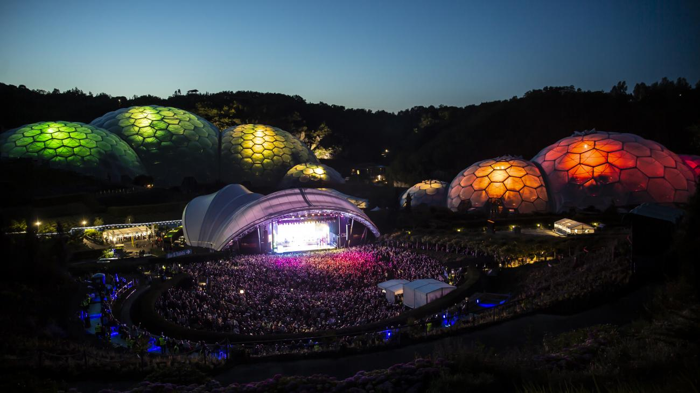
The Eden Sessions
Did you know?
The Eden Project run a series of music concerts every summer, called Eden Sessions
IMAGE

Slide 10
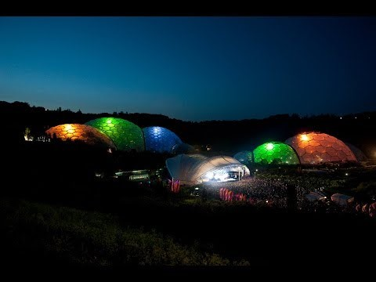
But, how can the Eden Project justify putting on an event like this?

Slide 11
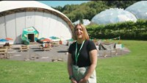
The Eden Sessions are used as to demonstrate how big events like this can be delivered in a far more sustainable way.

Slide 12
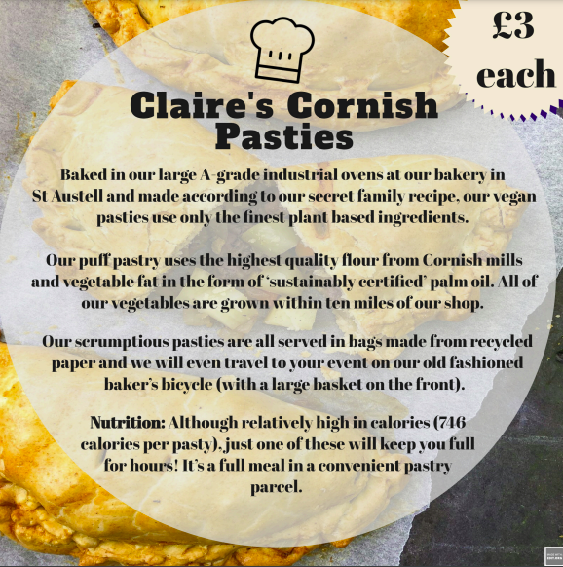
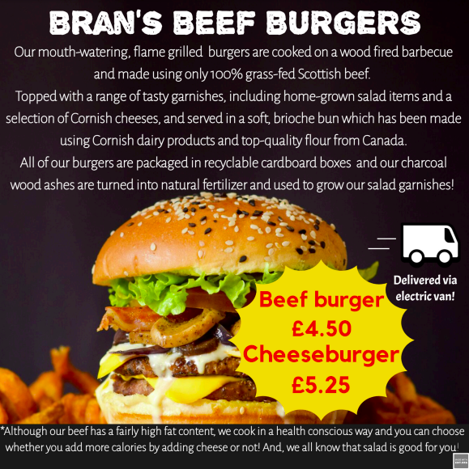
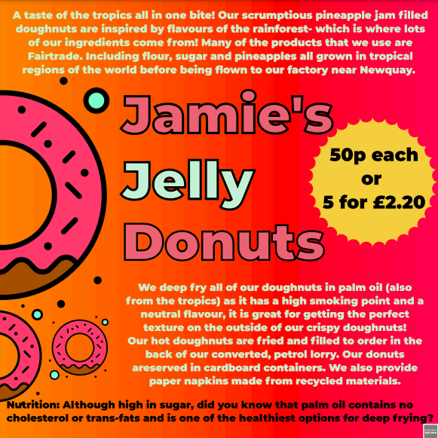
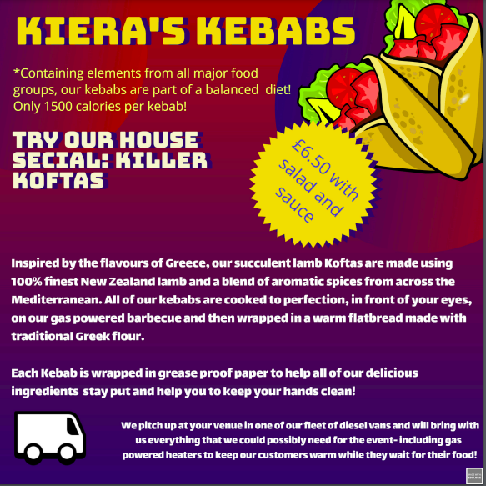
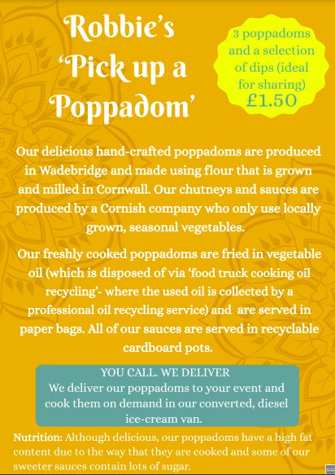

Challenge:
You are part of the Eden Sessions Management Team and have an important decision to make…
It is your job to choose one new sustainable food vendor that will be allowed to sell their food during the Eden Sessions.
You need to:
Read the information leaflets from all 5 potential food vendors.
Use your knowledge the Development Compass Rose to help you make the best decision you can in relation to Nature, Economy and Social.
You will need to be able to justify the choice that you have made.

Slide 13
Remember…
There is not necessarily always a clearly ‘right’ or ‘wrong’ answer.
It is important to remember that the decisions we make have a wider impact than we may have previously realised.
We need to be ‘critical thinkers’ and use the information that we have available to make the best choices that we can at the time.

Slide 14
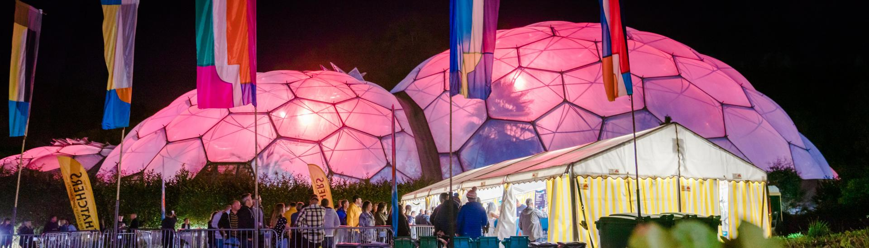
Challenge 2:
We want you to design your own food vender leaflet.
Your leaflet should be eye catching and describe delicious food, of your choice, that would appeal to people attending the Eden Sessions but that also fits Eden’s sustainable ethos.

Slide 15
Things to think about…
What will you make?
Where will your ingredients come from?
How will your food be cooked?
What will it be packaged in?
How will it be transported?
What will happen to any waste?

